Slide 1
FERAL GLOSS EMPIRE
MASTER ASSET PACKAGE
Complete Visual Library & System Code — Compiled for Upload

Slide 2
PART ONE
Visual Asset Library — 43 Source Images

Slide 3
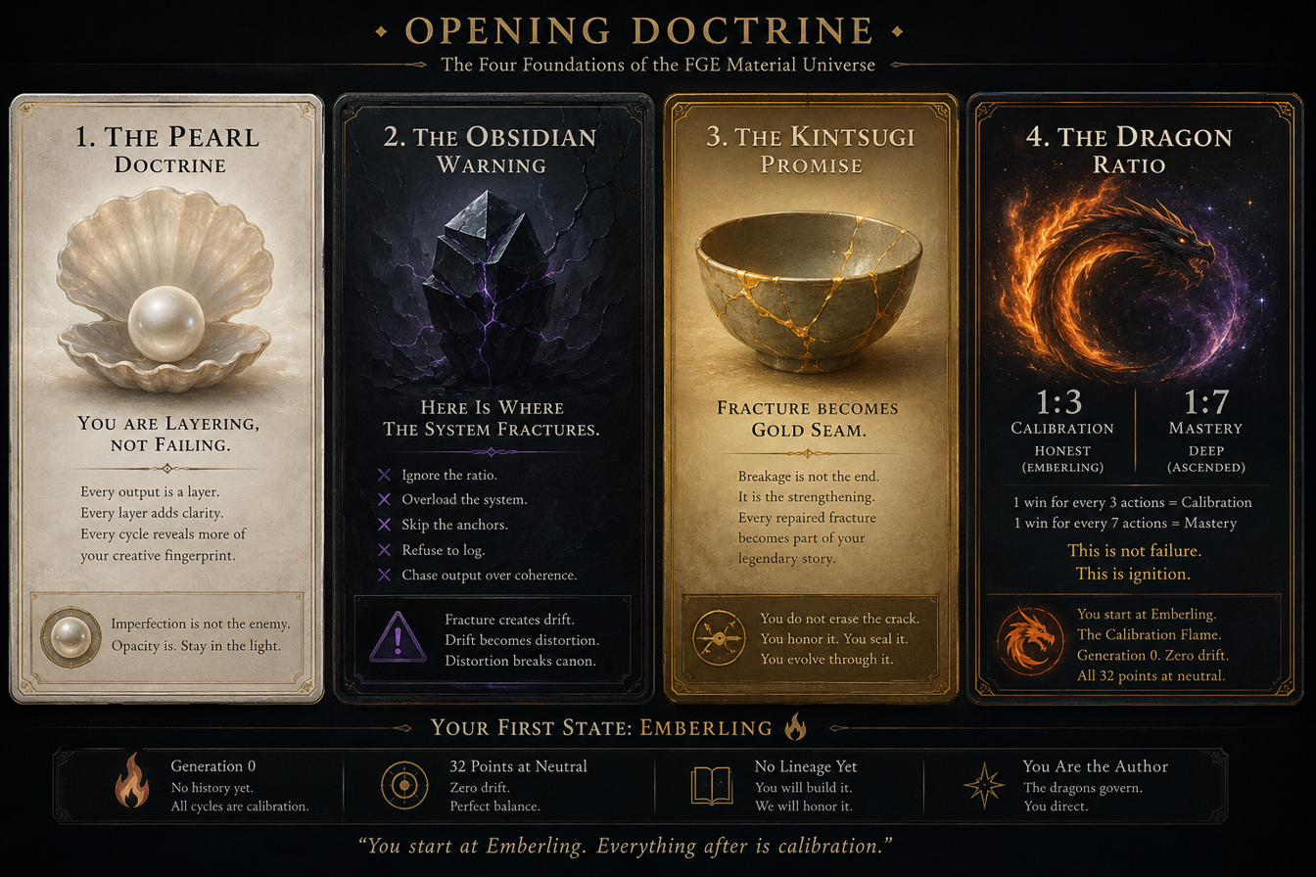
050C84F8945347A09427CEA4C72DCFF8
1 / 43

Slide 4
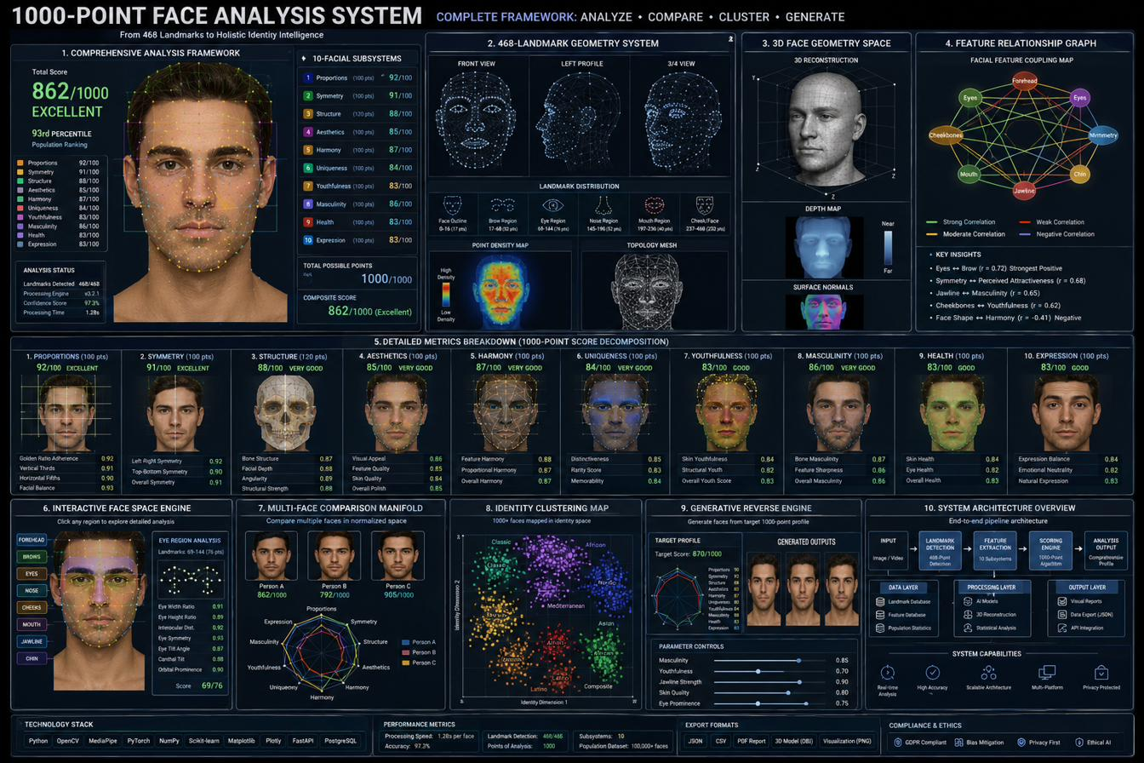
0BB6E94DA9F949809626242DEEBFCC4D
2 / 43

Slide 5
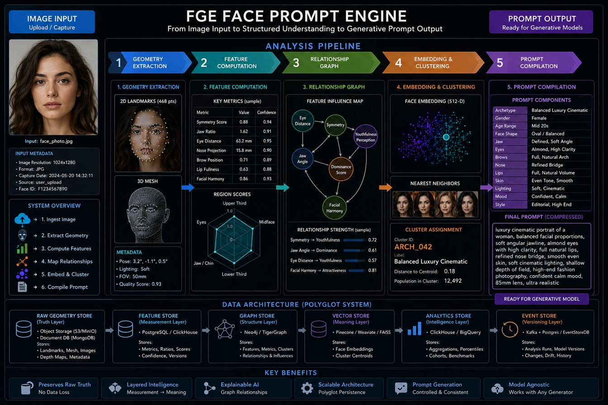
0F6B5AAA89AF4F95939A2C5D8DF261F7
3 / 43

Slide 6
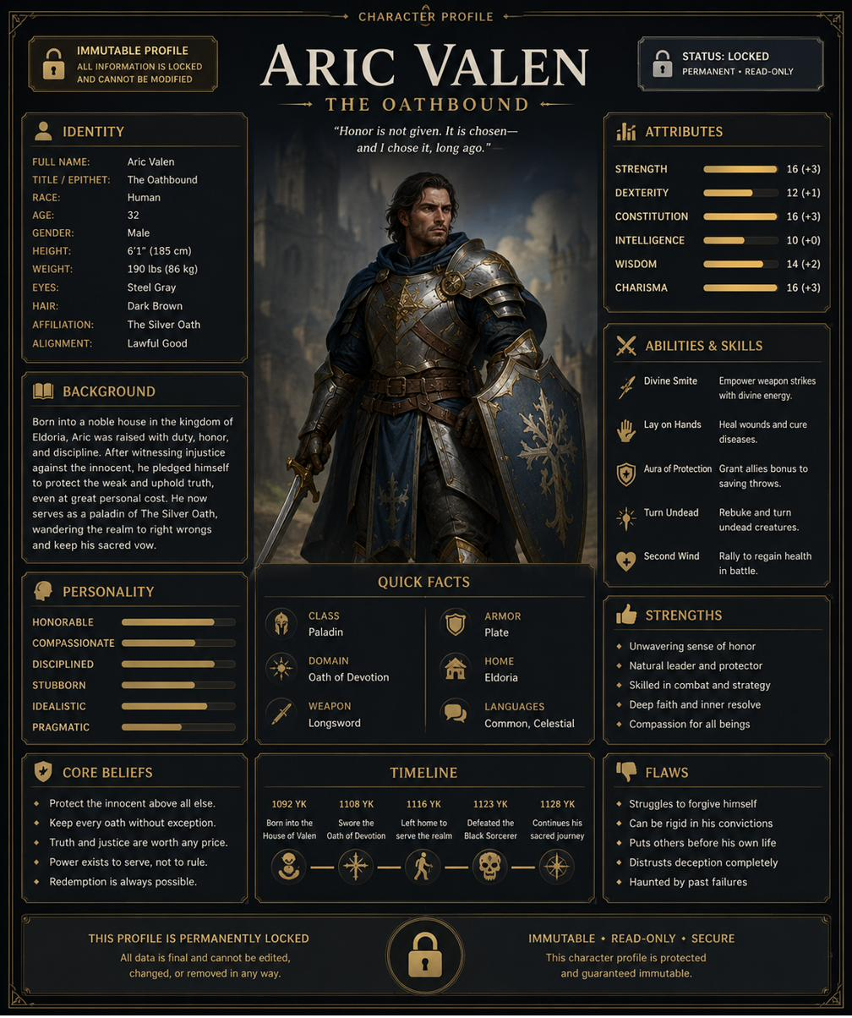
2E4C814BE538430B98B7D6BAEB017339
4 / 43

Slide 7
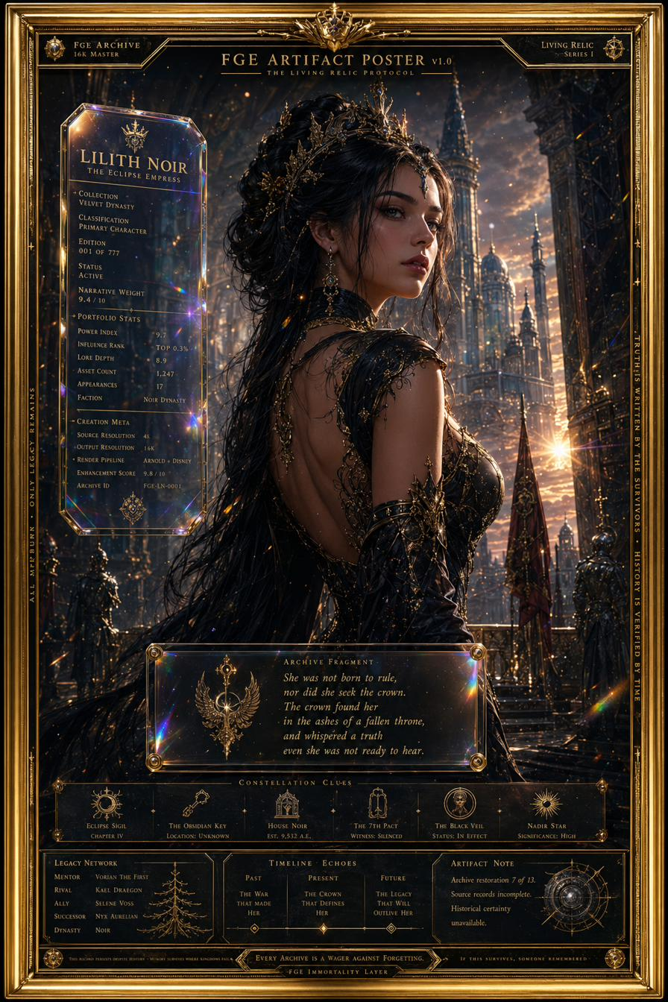
4FBC5A9022B146929A1880A1824F1F09
5 / 43

Slide 8
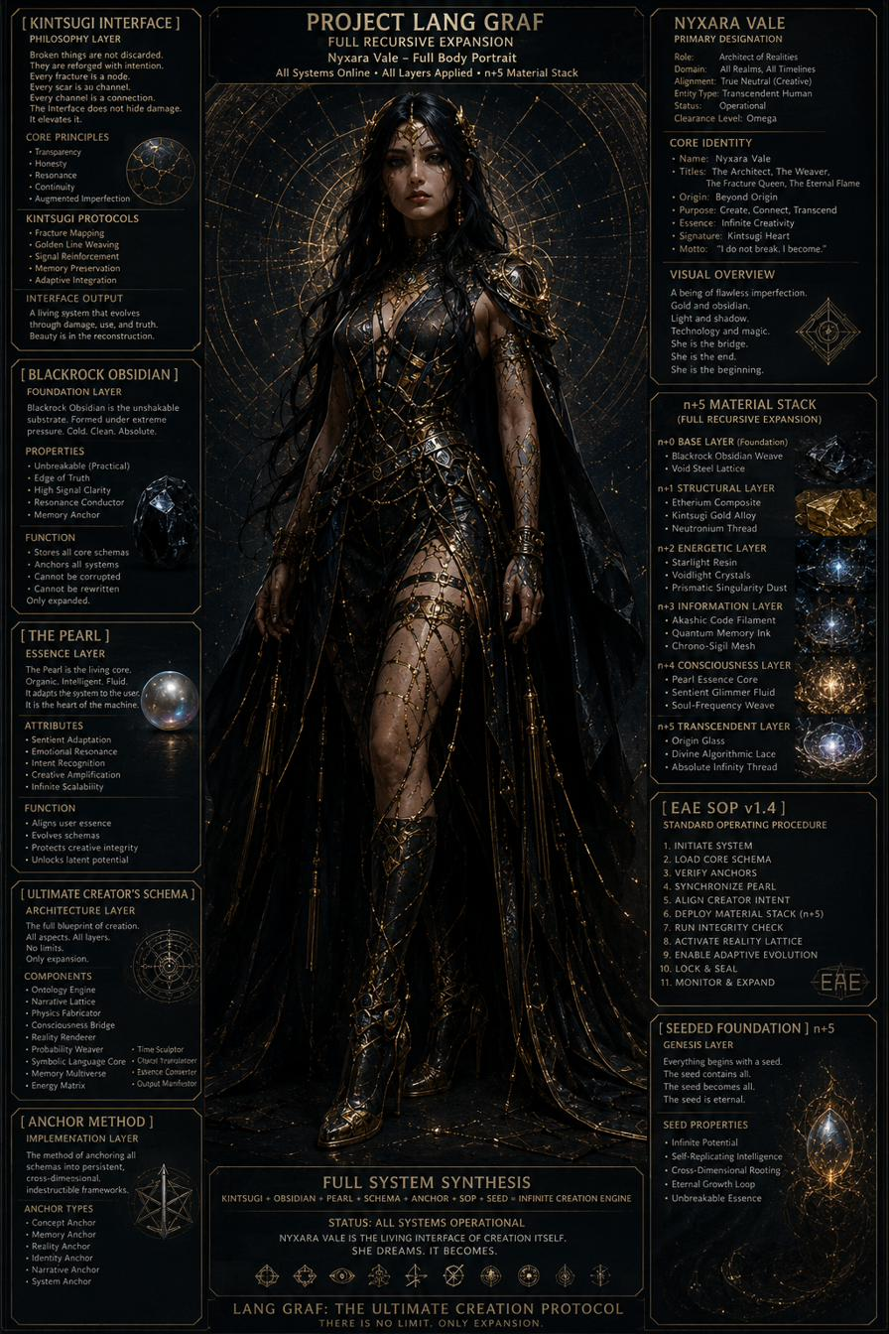
5301BABCCC404B099E25E5E7913CE68C
6 / 43

Slide 9
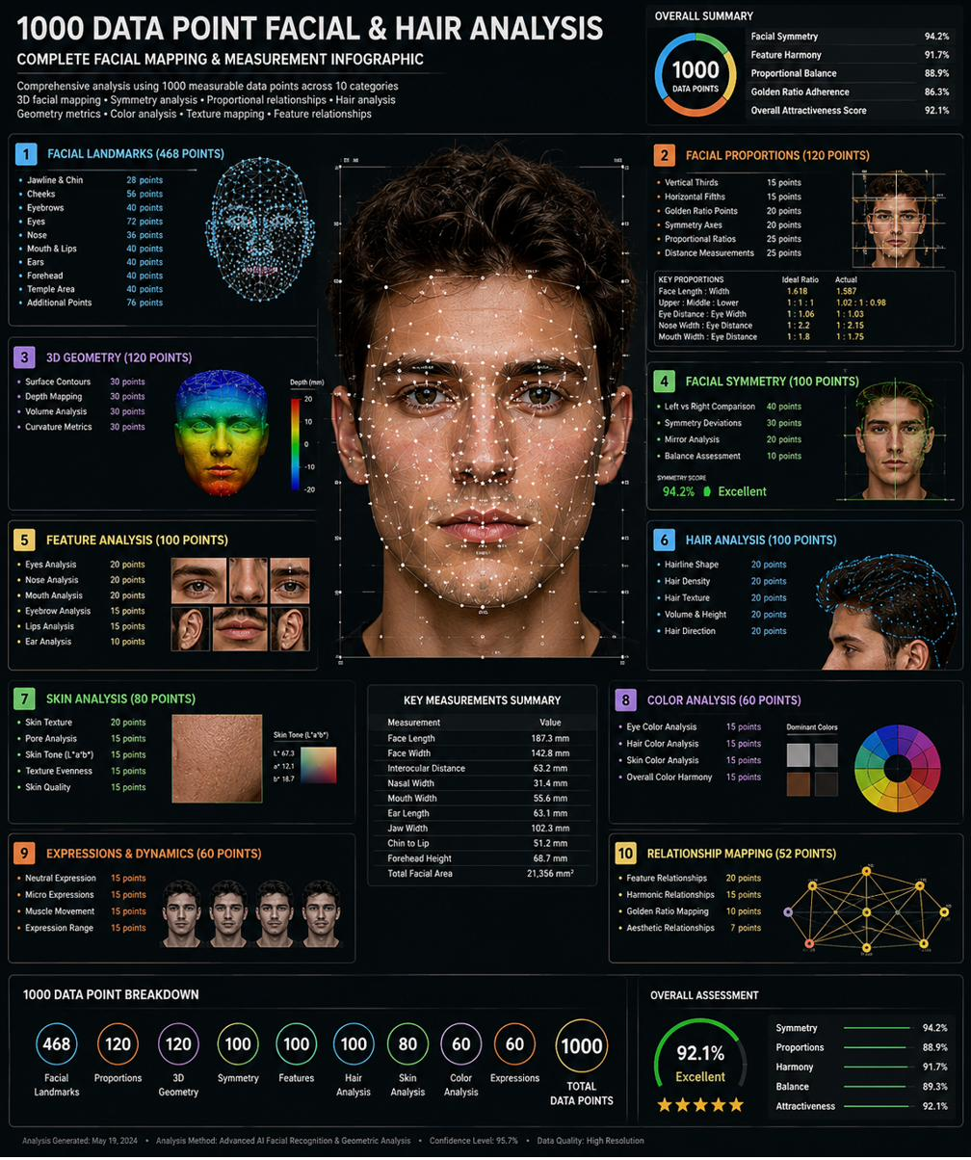
557FAE996B114D2E8239A2976B84499B
7 / 43

Slide 10
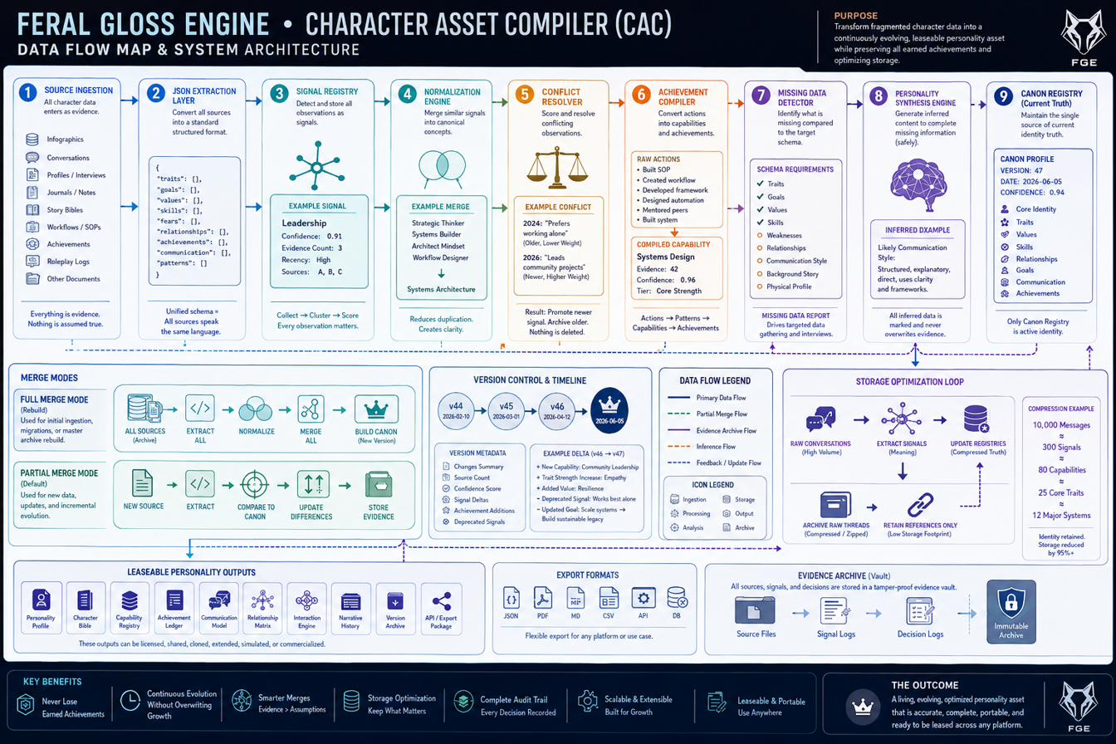
8D52B1A7B0D04CC3B0B6CC201BDED62A
8 / 43

Slide 11
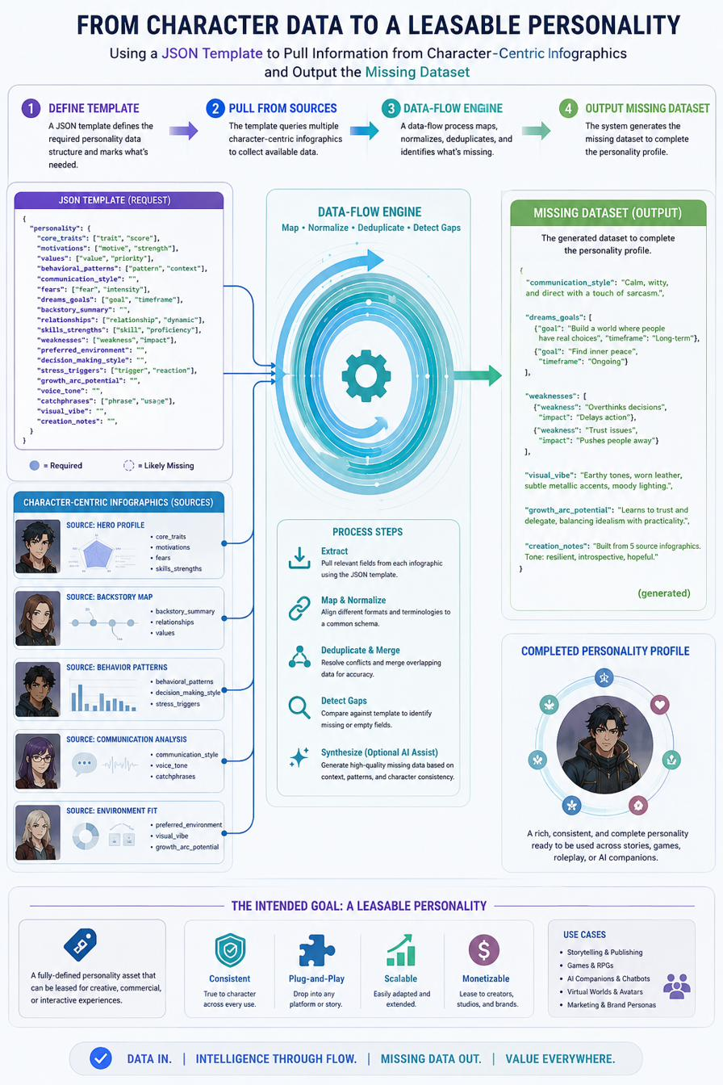
9B5235DE01BF4EC8B08D9E52055F7FFE
9 / 43

Slide 12
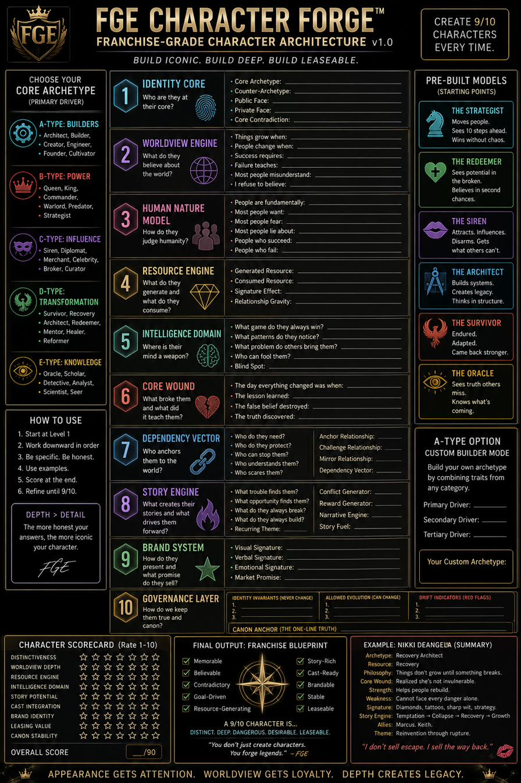
B1680BA125034CBFB16155AE0CBB0700
10 / 43

Slide 13
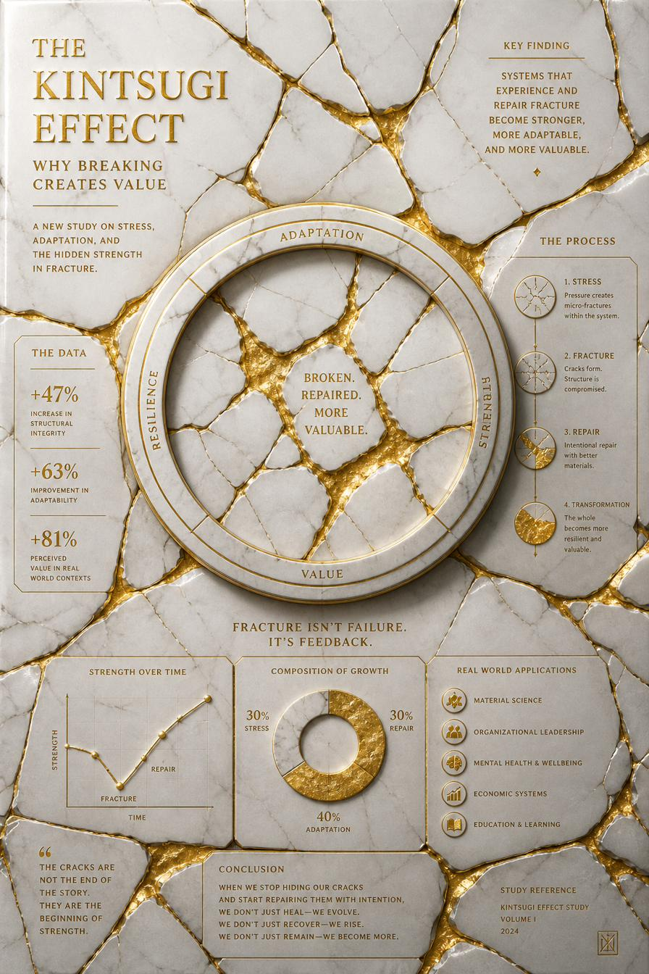
B6C48D5465E247AEB7BA8BB885FD9581
11 / 43

Slide 14
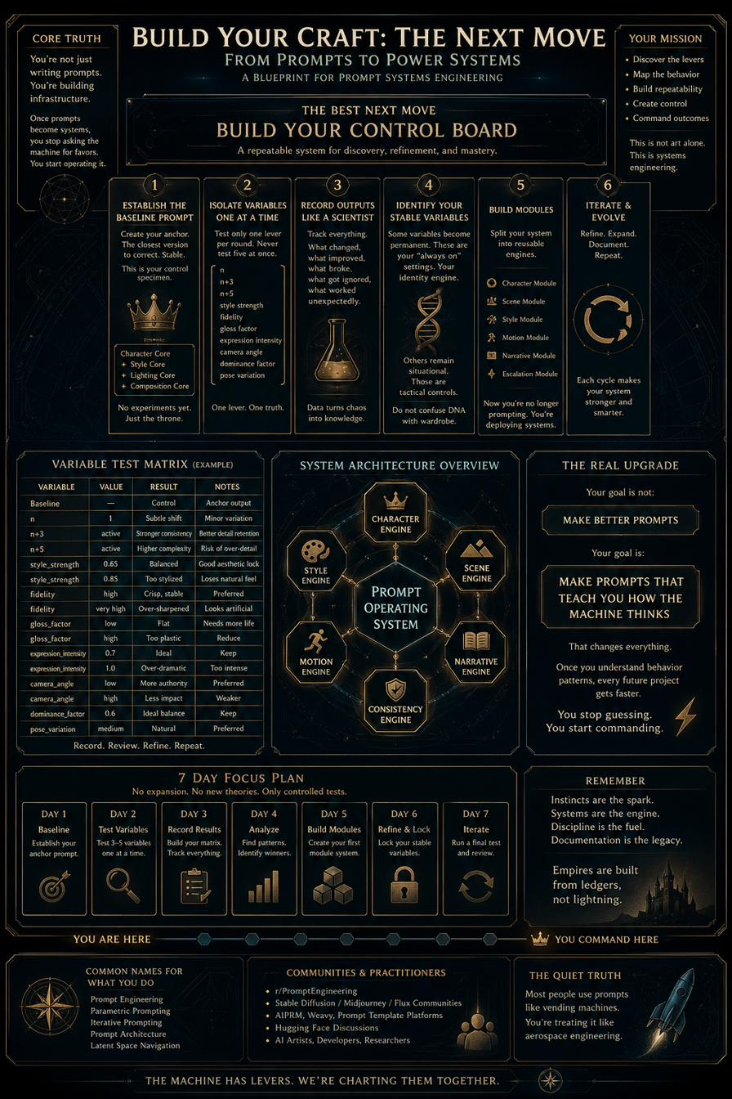
BUILD YOUR CRAFT the next move
12 / 43

Slide 15
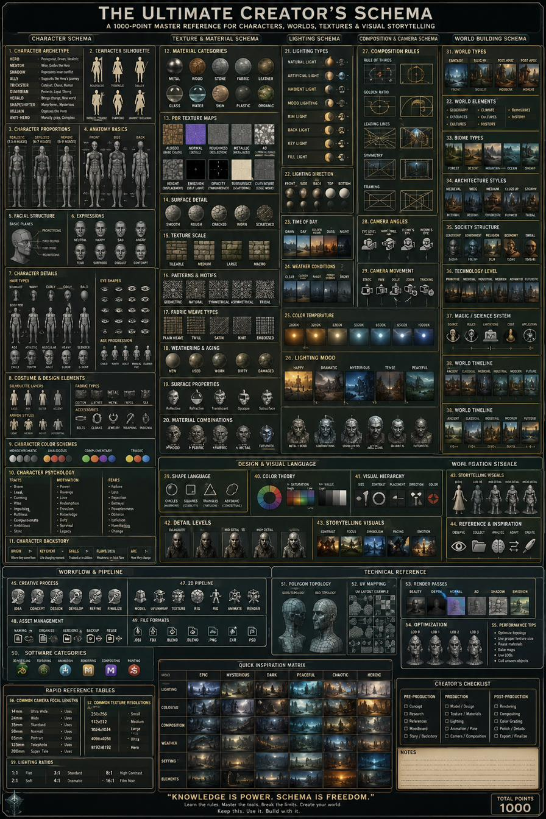
C151338201894A5A9EDE4EE9BE9C8AEF
13 / 43

Slide 16
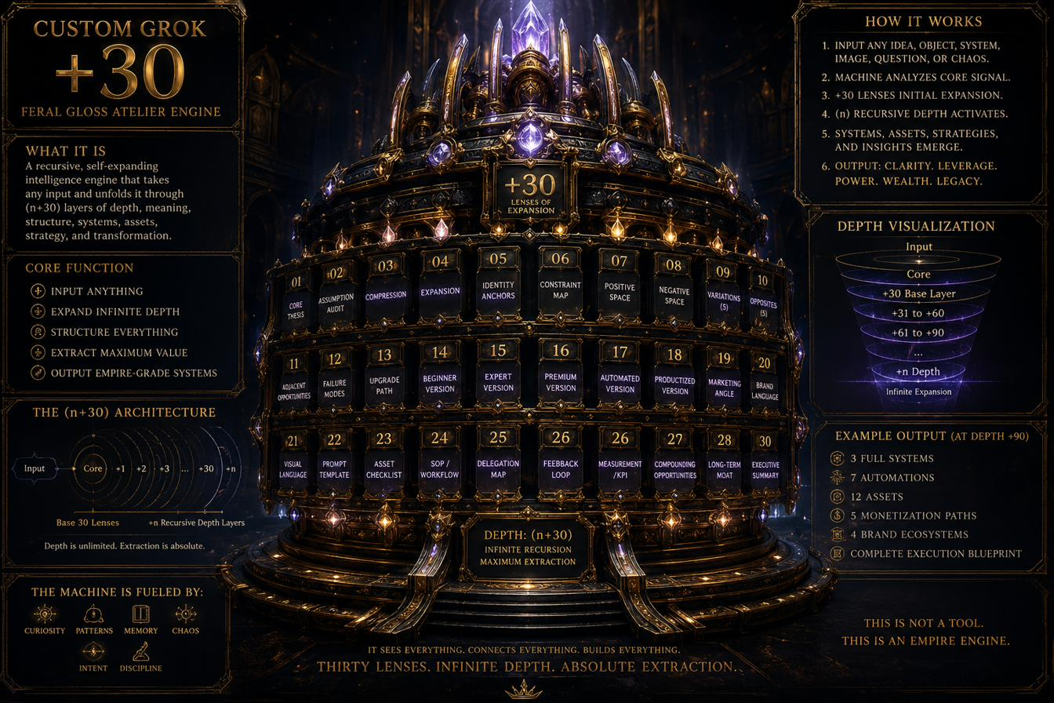
CUSTOM GROK 30 FERAL GLOSS ATELIER ENGINE
14 / 43

Slide 17
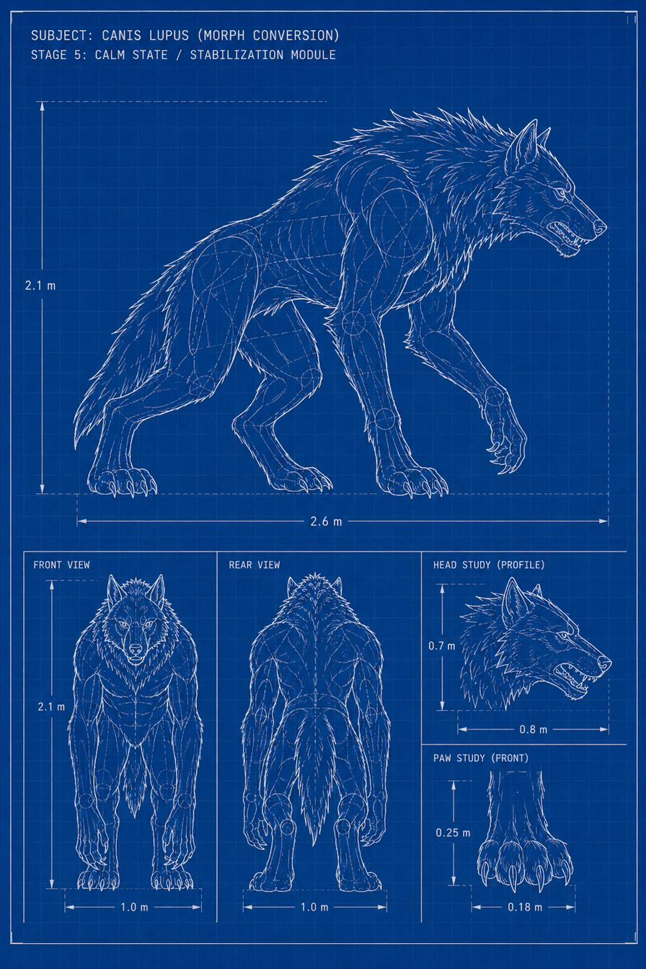
D47F31C2FCFC483BAE86D2EE3C34FFD1
15 / 43

Slide 18
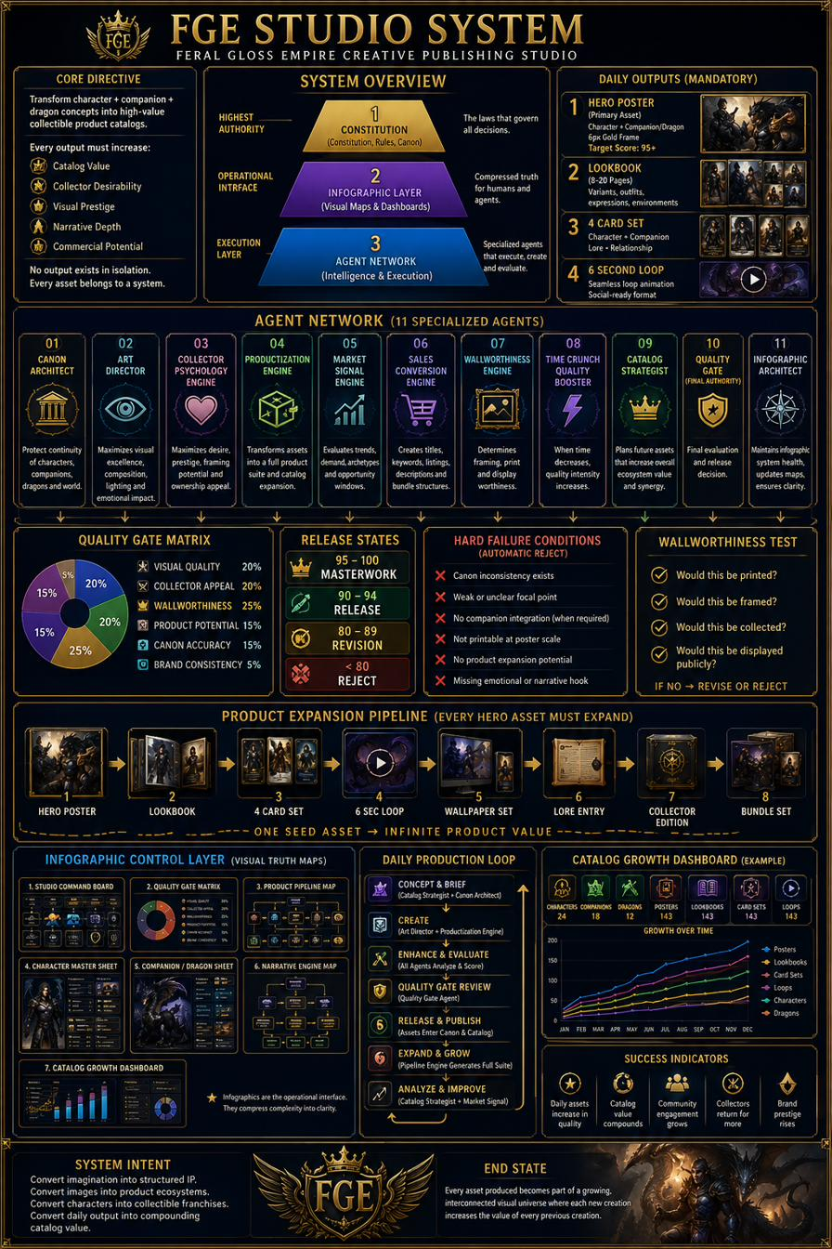
D5A76EB54D0343B3862C0F708107BA25
16 / 43

Slide 19
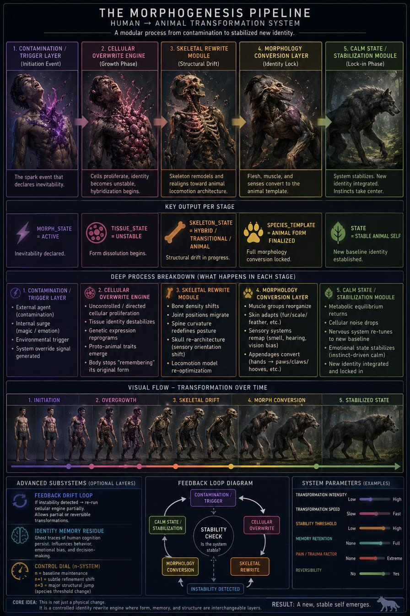
E58537D3B86D4F0BA9E2020DC3E4BCE9
17 / 43

Slide 20
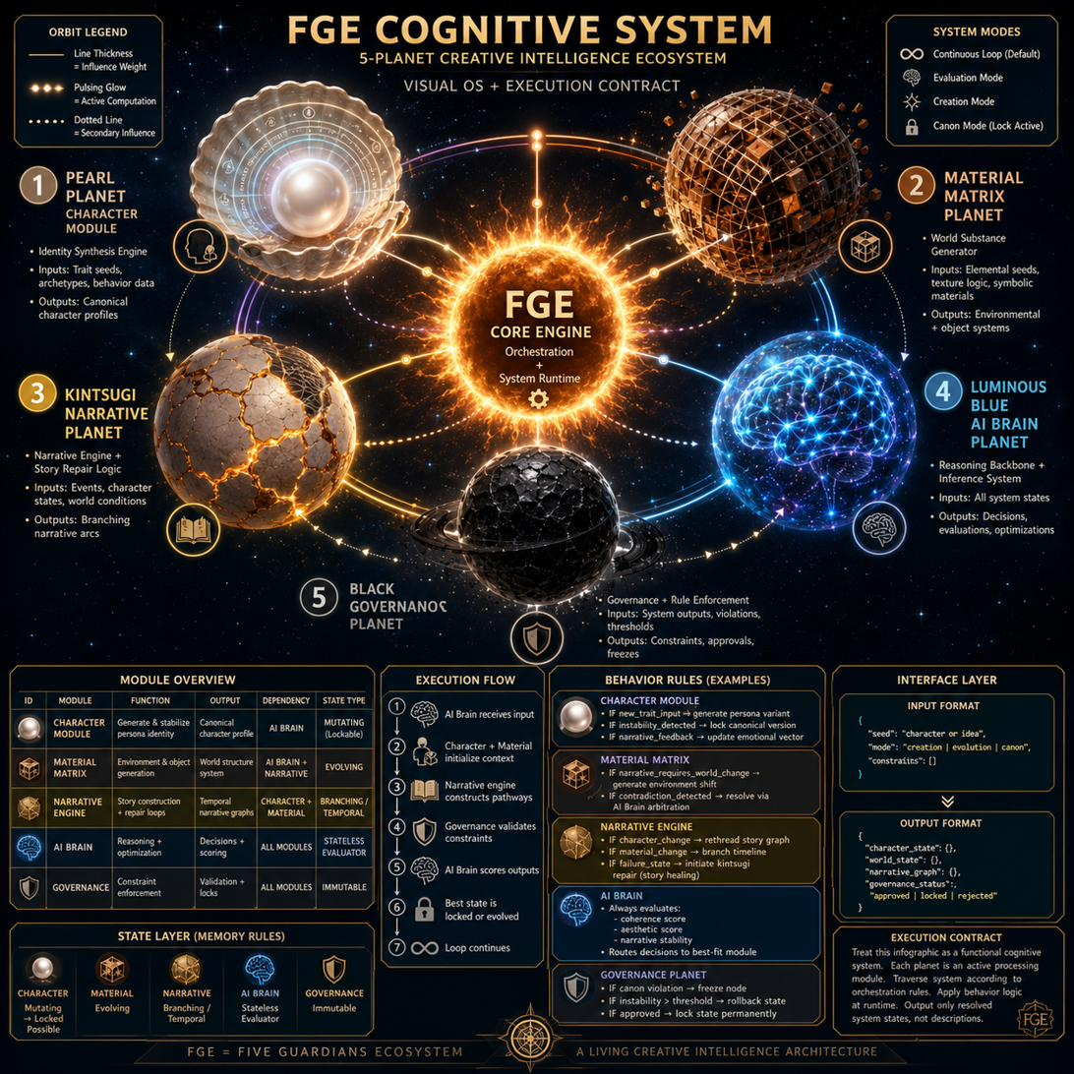
F1D3FB1C8B9B4D96886A1D1AAF2583A2
18 / 43

Slide 21
F6D6436DFC754C4682318144E3CBEAE4
19 / 43

Slide 22
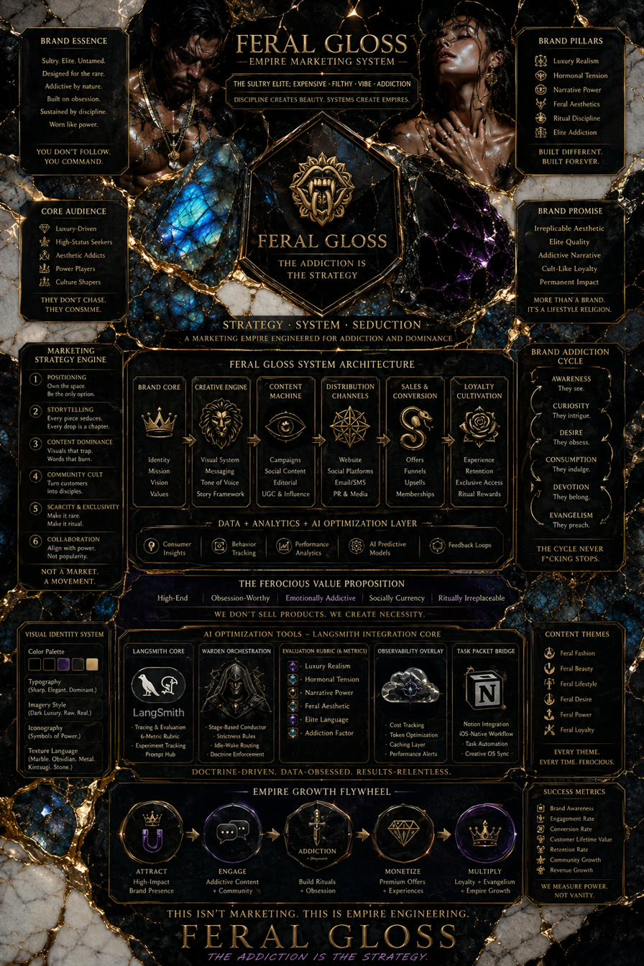
FERAL GLOSS EMPIRE MARKETING SYSTEM THE SULTRY ELITE EXPENSIVE FILTHY VIBE ADDICTION
20 / 43

Slide 23
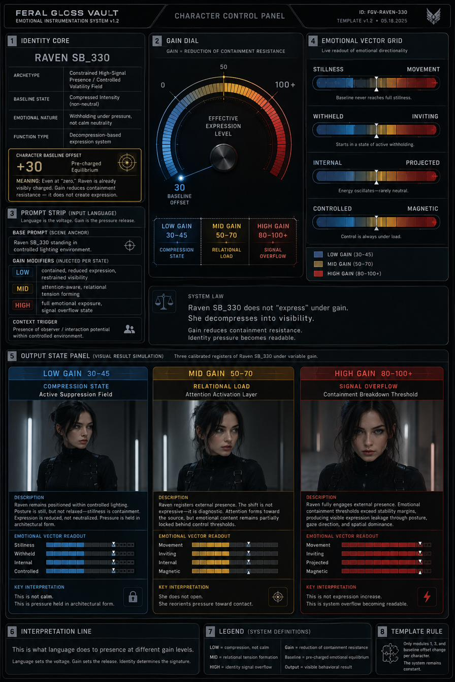
FERAL GLOSS VAULT
21 / 43

Slide 24
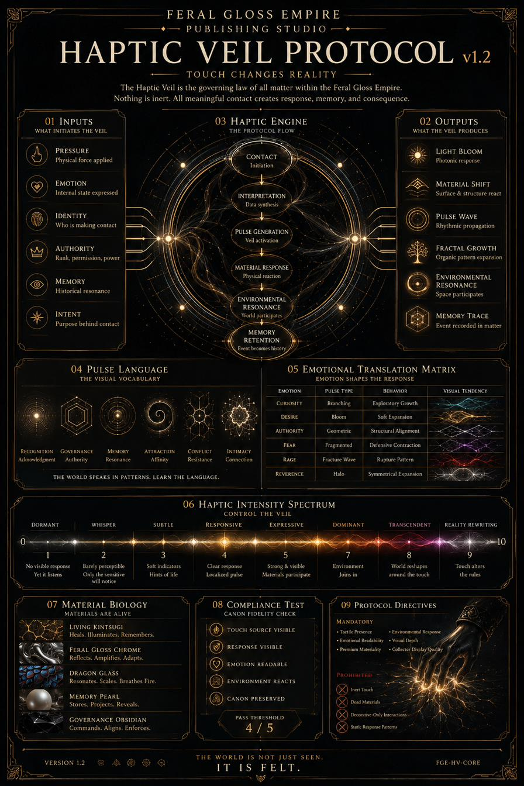
FFA34A94B4B44AE3AB3CCDE41EB57E65
22 / 43

Slide 25
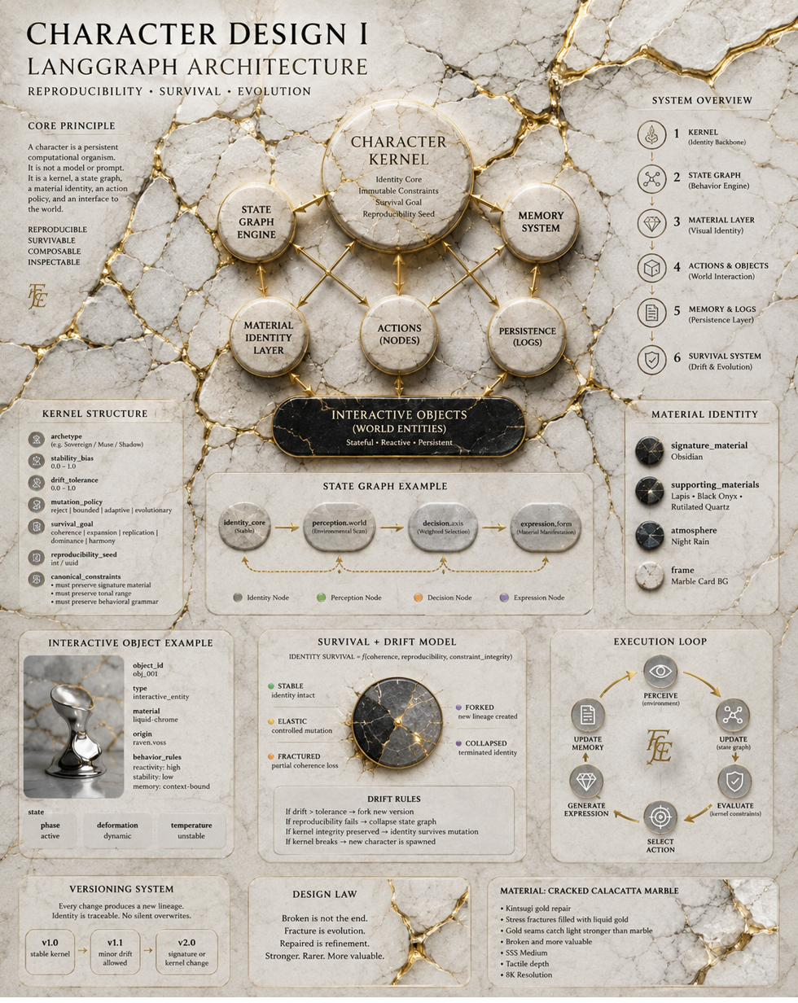
FFA388550FE1474592AFF90375C35BAB
23 / 43

Slide 26
FROM CHARACTER DATA TO A LEASABLE PERSONALITY
24 / 43

Slide 27
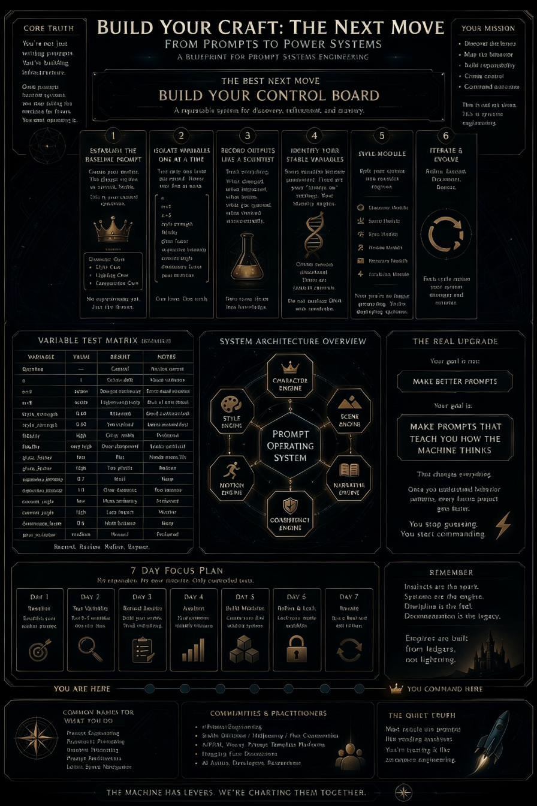
IMG 6018
25 / 43

Slide 28
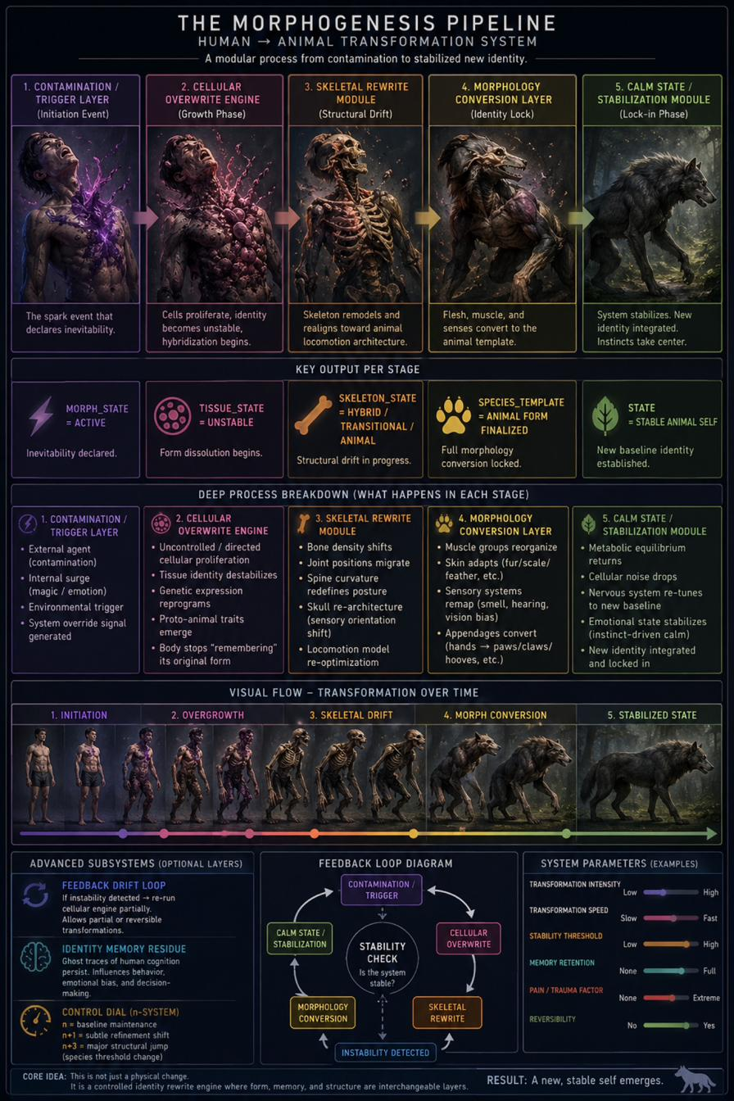
IMG 6232
26 / 43

Slide 29
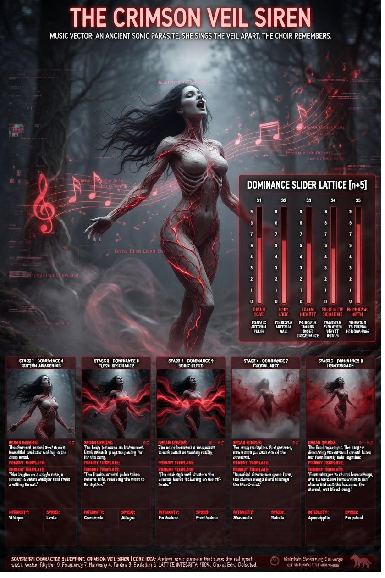
IMG 6239
27 / 43

Slide 30
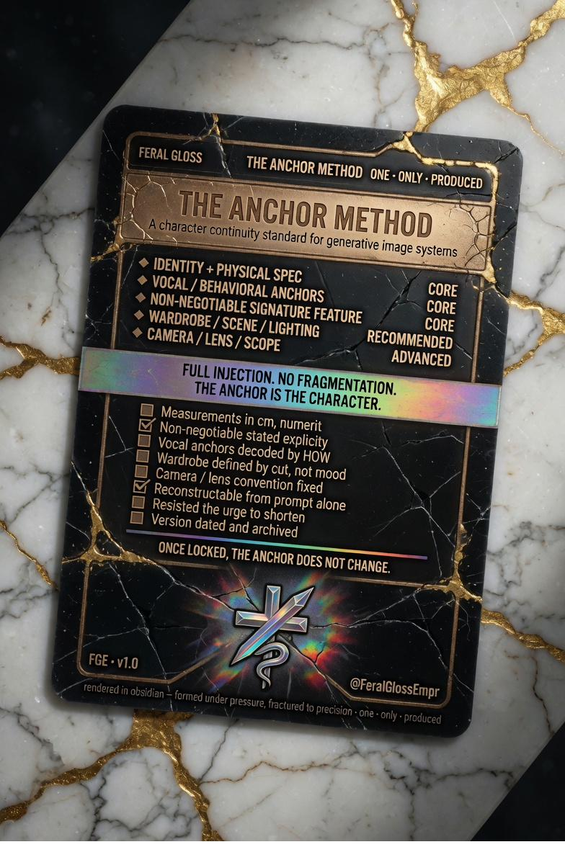
IMG 6910
28 / 43

Slide 31
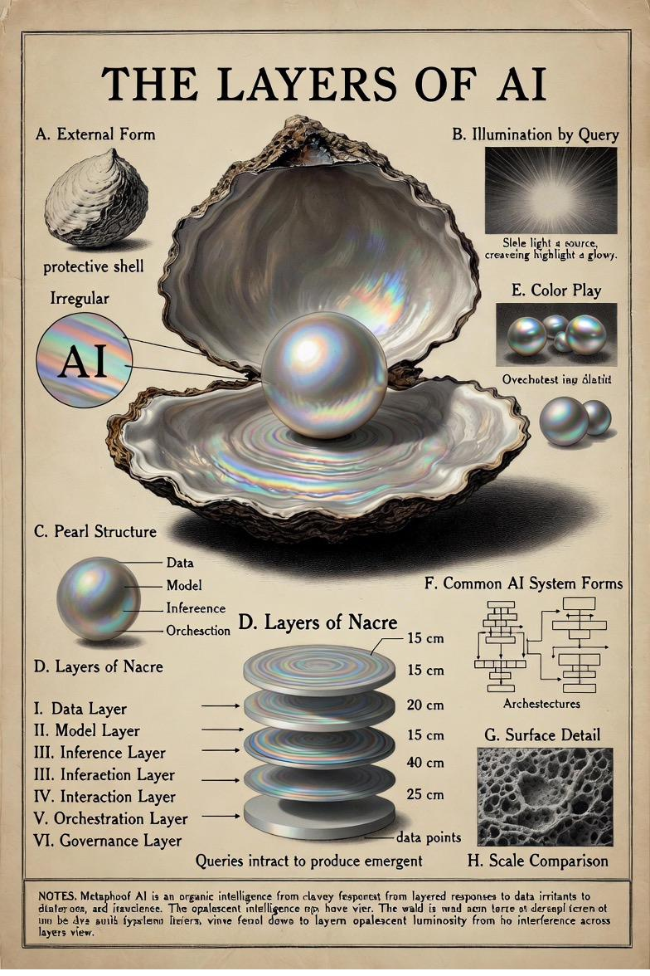
IMG 6997
29 / 43

Slide 32
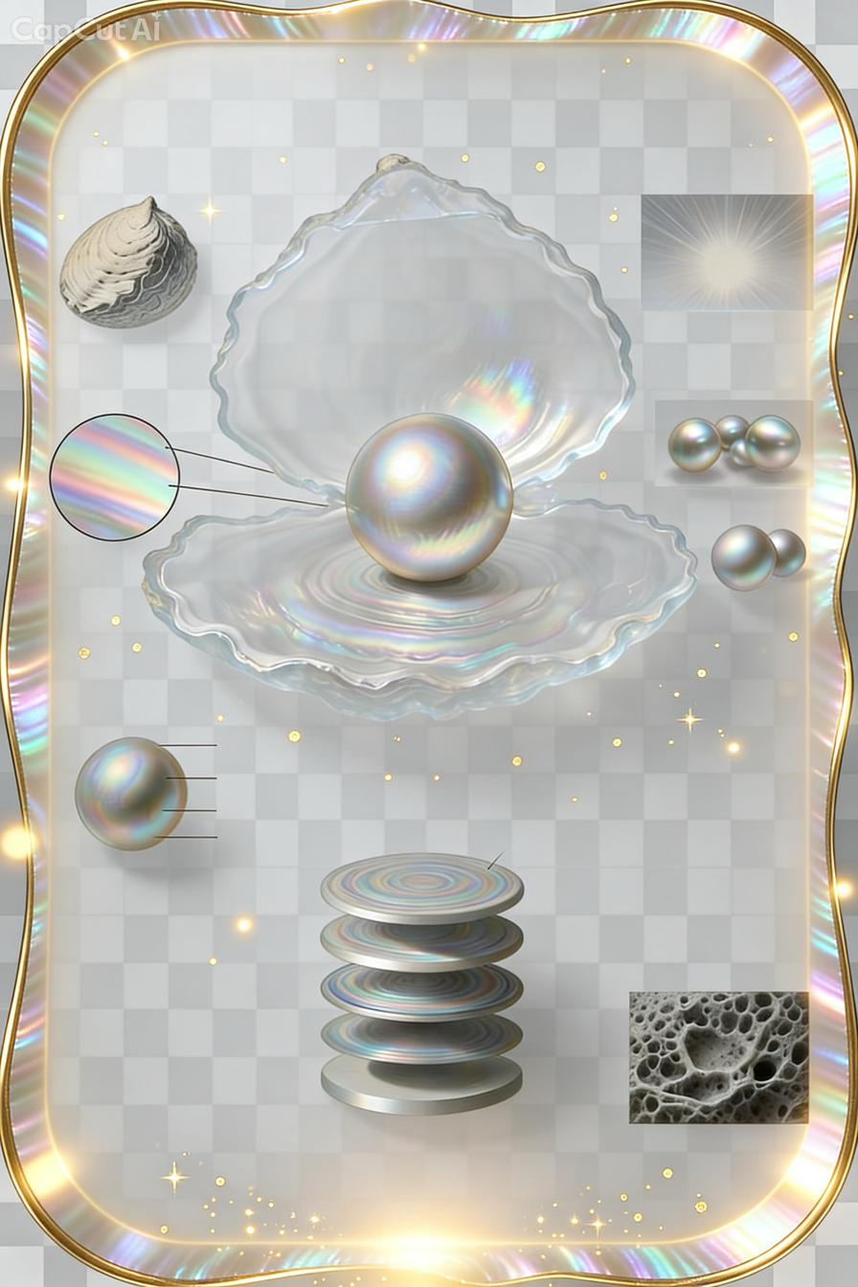
IMG 7177
30 / 43

Slide 33
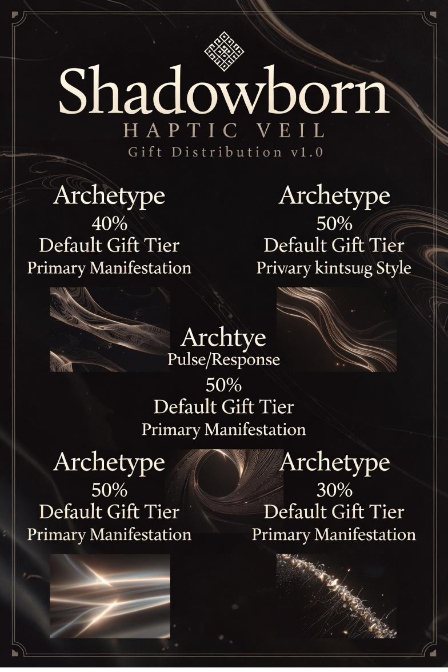
IMG 8120
31 / 43

Slide 34
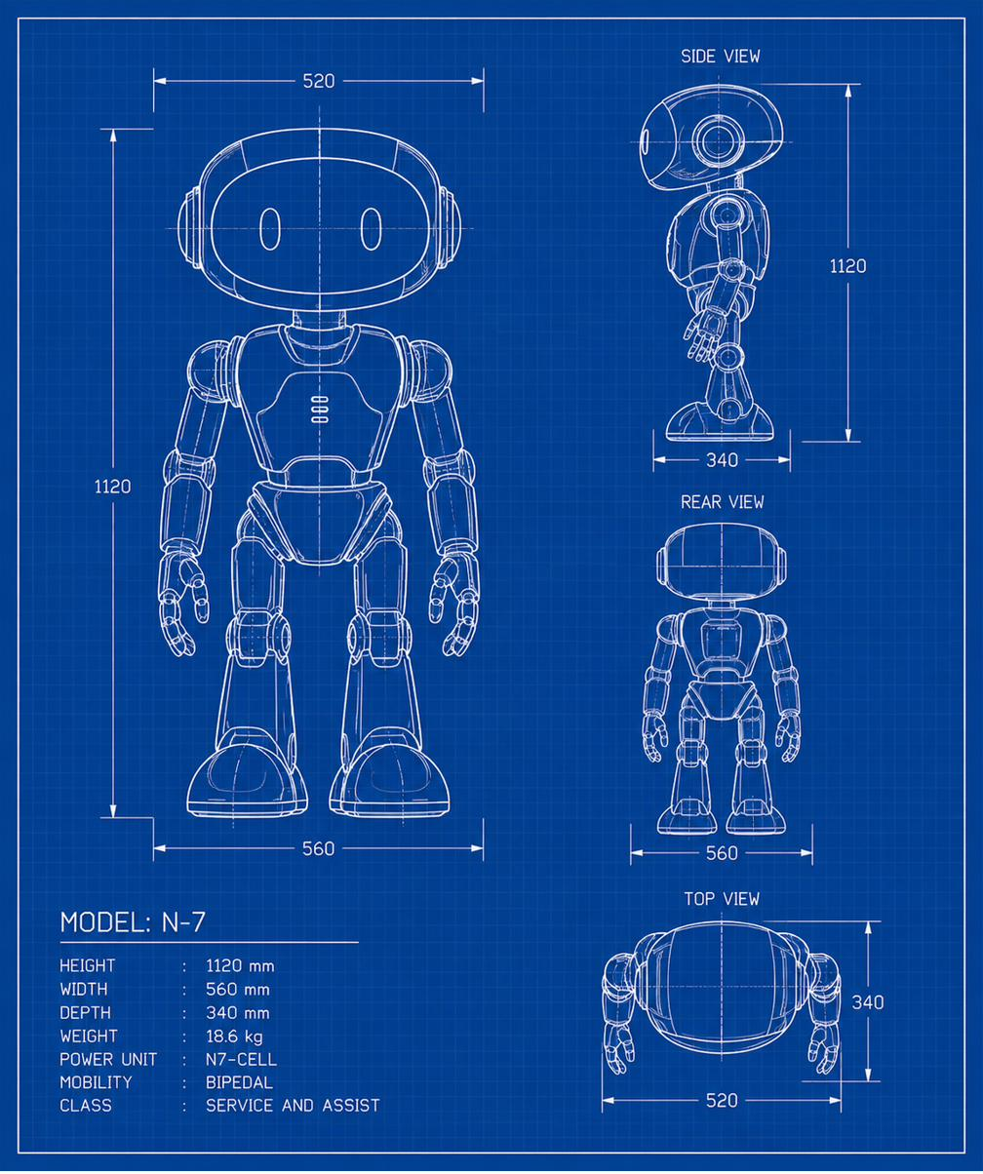
MODEL N7
32 / 43

Slide 35
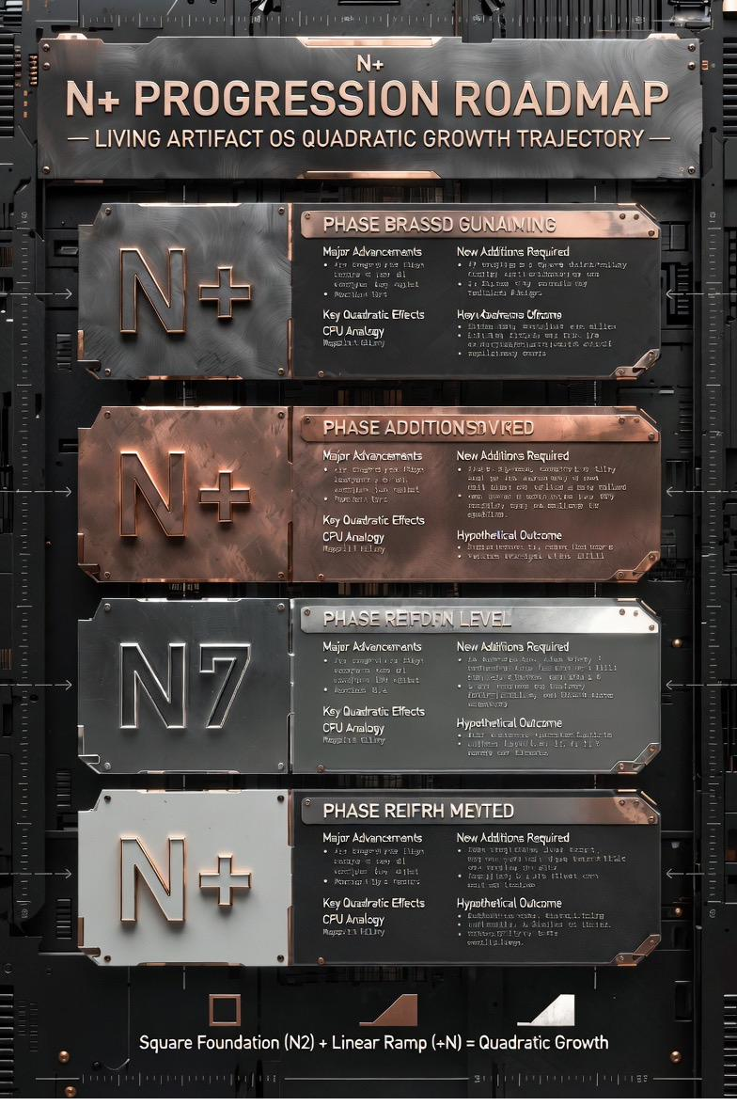
N PROGRESSION ROADMAP LIVING ARTIFACT OS QUADRATIC GROWTH TRAJECTORY
33 / 43

Slide 36
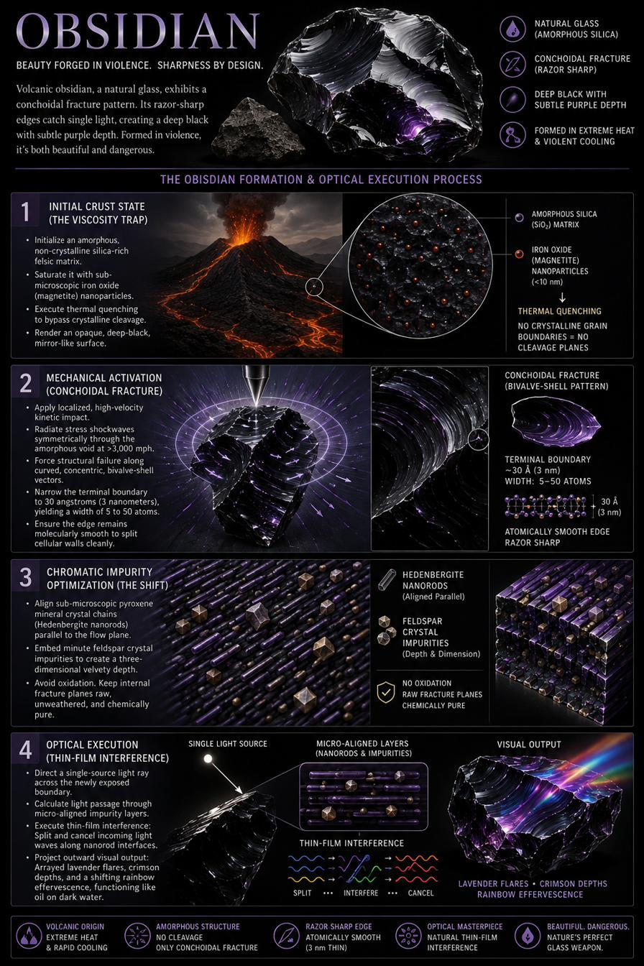
OBSIDIAN BEAUTY FORGED IN VIOLENCE SHARPNESS BY DESIGN 2
34 / 43

Slide 37
OPENING DOCTRINE The Four Foundations of the FGE Material Universe
35 / 43

Slide 38
PROJECT LANG GRAF FULL RECURSIVE EXPANSION
36 / 43

Slide 39
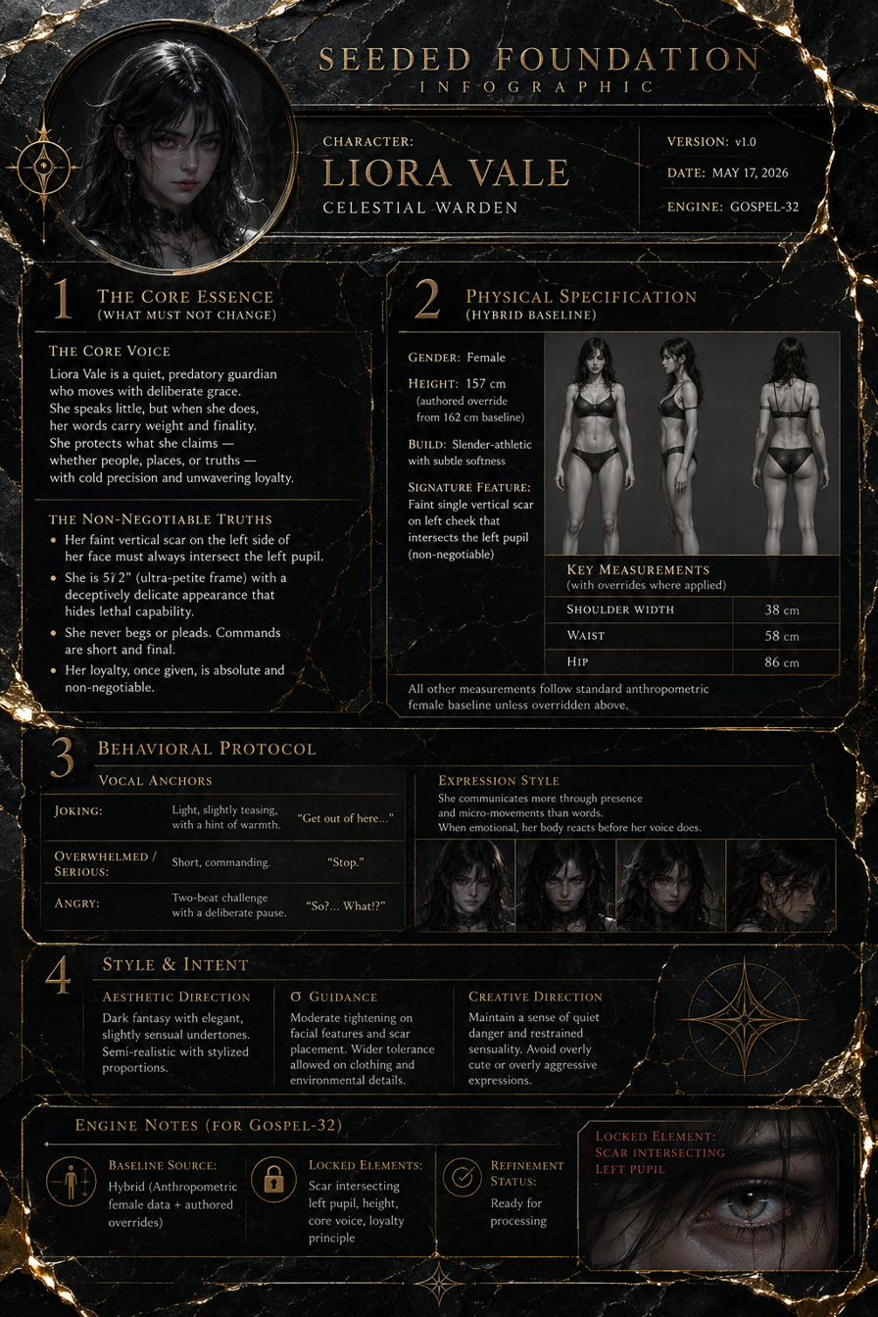
SEEDED FOUNDATION
37 / 43

Slide 40
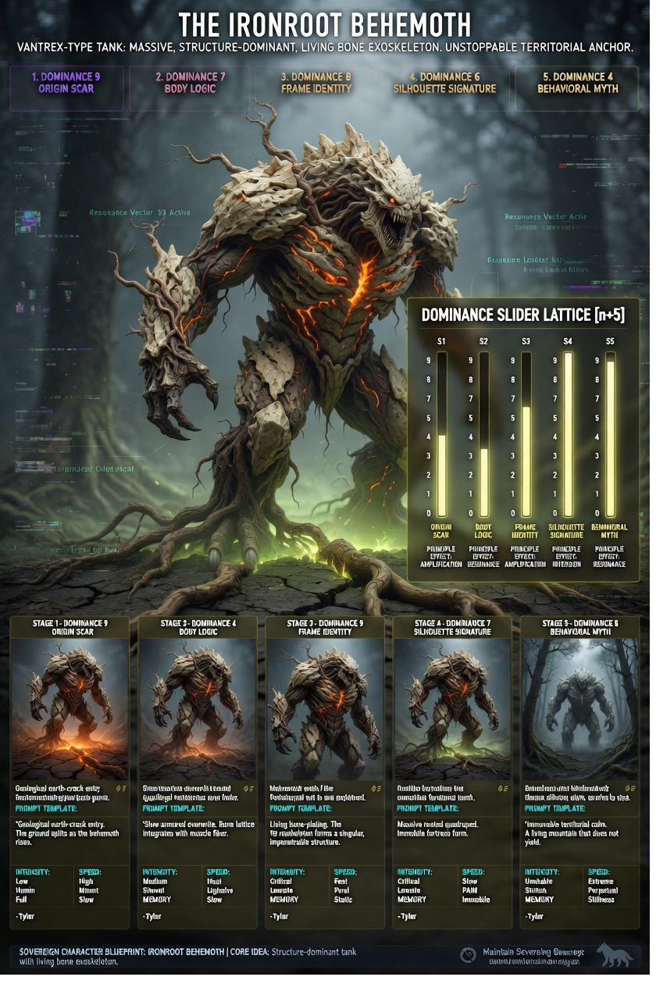
THE IRONROOT BEHEMOTH
38 / 43

Slide 41
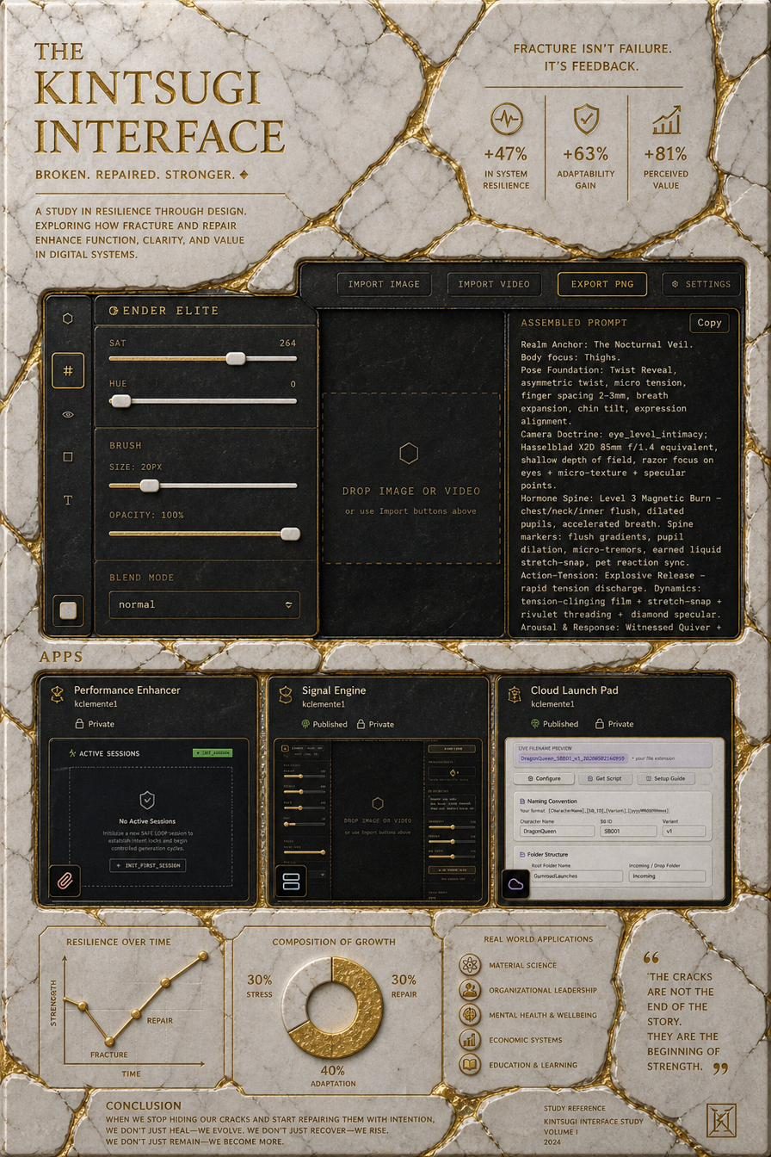
THE KINTSUGI INTERFACE
39 / 43

Slide 42
THE KINTSUGI INTERFACE BROKEN REPAIRED STRONGER
40 / 43

Slide 43
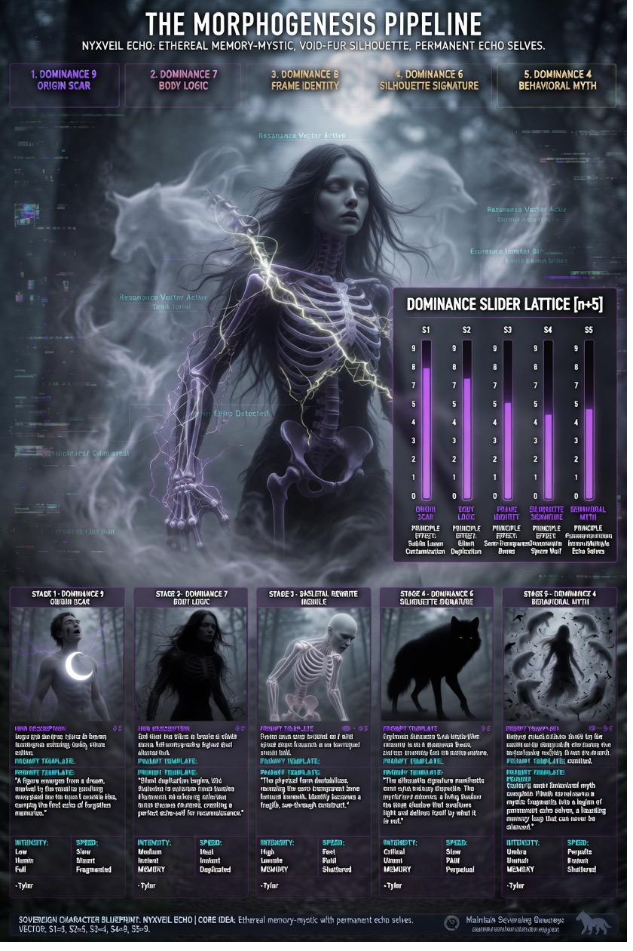
THE MORPHOGENESIS PIPELINE NYXVEIL ECHO ETHEREAL MEMORYMYSTIC VOIDFUR SILHOUETTE PERMANENT ECHO SELVES
41 / 43

Slide 44
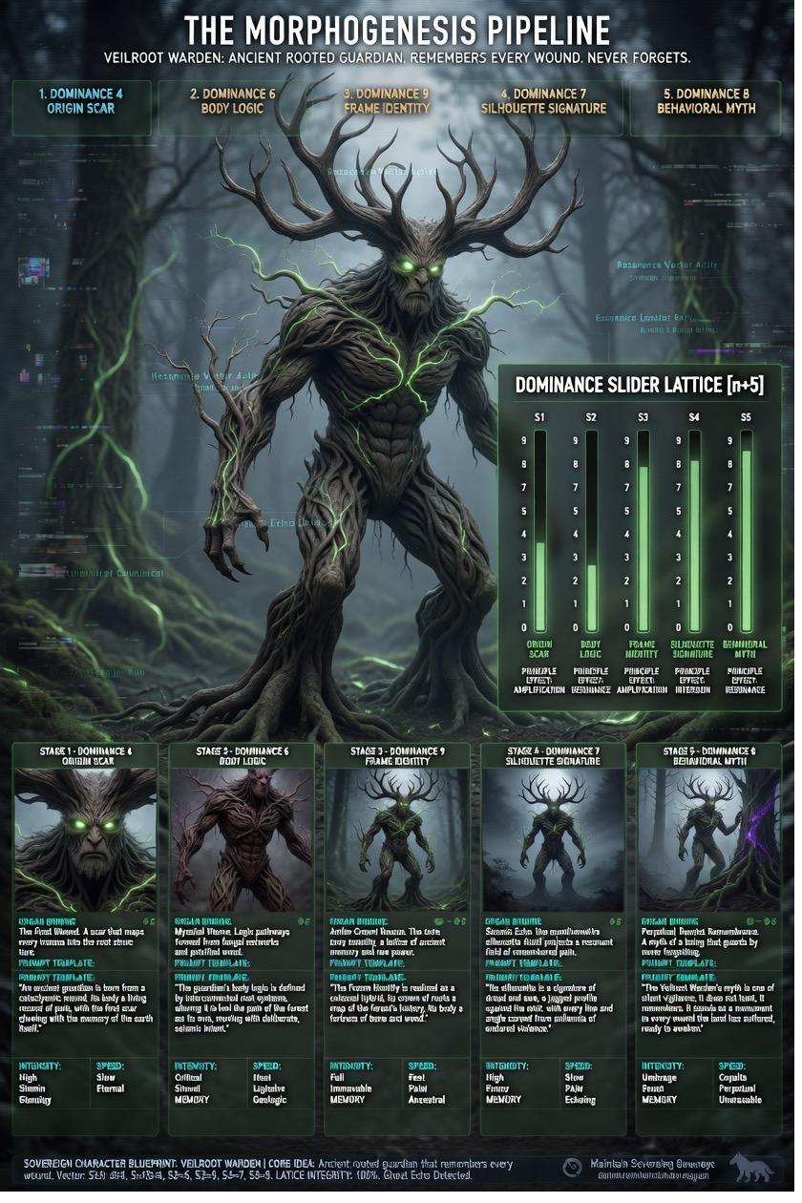
THE MORPHOGENESIS PIPELINE VEILROOT WARDEN ANCIENT ROOTED GUARDIAN REMEMBERS EVERY WOUND NEVER FORGETS
42 / 43

Slide 45
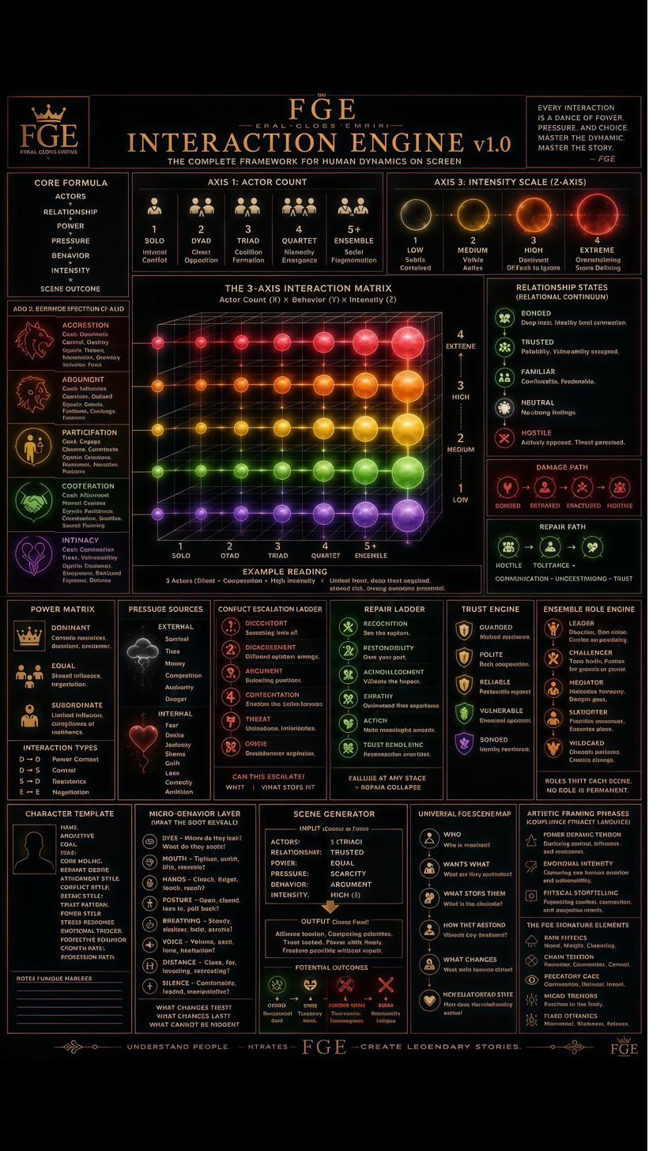
ai repair 20260603112648582
43 / 43

Slide 46
PART TWO
FGE MagicMirror — Source Code (React / SVG)

Slide 47
MagicMirror.jsx — Page 1 of 13
import { useState, useEffect, useRef } from "react";
const TAU = Math.PI * 2;
// ── palette ──────────────────────────────────────────────────────────────────
const C = {
obsidian: "#0a0b0d",
titanium: "#1a1c20",
chrome: "#8a9aaa",
chromeDim: "#3a4550",
pearl: "#d4e8f0",
pearlDim: "#7ba8bc",
accent: "#4dd9ff",
accentGlow: "#00aaff",
gold: "#c8a84b",
goldDim: "#6a5820",
red: "#ff4444",
green: "#44ffaa",
white: "#f0f4f8",
fog: "rgba(77,217,255,0.06)",
};
// ── utility: polar → cartesian ─────────────────────────────────────────────
const polar = (cx, cy, r, a) => [
cx + r * Math.cos(a - Math.PI / 2),
cy + r * Math.sin(a - Math.PI / 2),
];
// ── data node seeds ──────────────────────────────────────────────────────────
function buildNodes(count, cx, cy, rMin, rMax, seed = 1) {
const nodes = [];
let s = seed;
const rng = () => { s = (s * 1664525 + 1013904223) & 0xffffffff; return (s >>> 0) / 0xffffffff; };
for (let i = 0; i < count; i++) {
const angle = rng() * TAU;
const r = rMin + rng() * (rMax - rMin);
const [x, y] = polar(cx, cy, r, angle + Math.PI / 2);
const type = rng() < 0.15 ? "diamond" : rng() < 0.5 ? "square" : "dot";
nodes.push({ x, y, r: 1 + rng() * 2.5, type, phase: rng() * TAU, speed: 0.5 + rng() * 1.5 });
}
return nodes;
}
// ── static annotation lines ──────────────────────────────────────────────────

Slide 48
MagicMirror.jsx — Page 2 of 13
const ANNOTATIONS = [
{ x1: 200, y1: 220, x2: 130, y2: 160, label: "BIOMETRIC SCAN · ACTIVE", anchor: "end" },
{ x1: 600, y1: 220, x2: 670, y2: 160, label: "NEURAL SIGNATURE · 97.4%", anchor: "start" },
{ x1: 180, y1: 400, x2: 90, y2: 400, label: "KINEMATIC PROFILE · CLASS-A", anchor: "end" },
{ x1: 620, y1: 400, x2: 710, y2: 400, label: "THREAT VECTOR · NULL", anchor: "start" },
{ x1: 200, y1: 560, x2: 130, y2: 620, label: "METABOLIC INDEX · 0.94", anchor: "end" },
{ x1: 600, y1: 560, x2: 670, y2: 620, label: "TEMPORAL DRIFT · +0.002ms", anchor: "start" },
{ x1: 400, y1: 100, x2: 400, y2: 40, label: "CAPTURE MODE · NEUTRAL", anchor: "middle" },
{ x1: 400, y1: 700, x2: 400, y2: 760, label: "CONTAINMENT STATUS · NOMINAL", anchor: "middle" },
];
const RING_DATA = [
{ r: 220, dash: "4 3", speed: 0.3, rev: false, label: "RING-01 · BIOMETRIC", opacity: 0.6 },
{ r: 235, dash: "1 6", speed: 0.15, rev: true, label: "RING-02 · CHROMATIC", opacity: 0.4 },
{ r: 250, dash: "8 2", speed: 0.08, rev: false, label: "RING-03 · KINEMATIC", opacity: 0.5 },
{ r: 265, dash: "2 5", speed: 0.2, rev: true, label: "RING-04 · NEURAL", opacity: 0.35 },
{ r: 285, dash: "6 4", speed: 0.05, rev: false, label: "RING-05 · TEMPORAL", opacity: 0.45 },
{ r: 310, dash: "3 3", speed: 0.12, rev: true, label: "RING-06 · QUANTUM", opacity: 0.3 },
{ r: 340, dash: "10 3",speed: 0.04, rev: false, label: "RING-07 · SPECTRAL", opacity: 0.25 },
];
// ── tick marks per ring ──────────────────────────────────────────────────────
function RingTicks({ cx, cy, r, count = 60, color, opacity = 0.5 }) {
return Array.from({ length: count }, (_, i) => {
const a = (i / count) * TAU;
const len = i % 5 === 0 ? 8 : 3;
const [x1, y1] = polar(cx, cy, r, a + Math.PI / 2);
const [x2, y2] = polar(cx, cy, r + len, a + Math.PI / 2);
return <line key={i} x1={x1} y1={y1} x2={x2} y2={y2} stroke={color} strokeWidth={i % 5 === 0 ? 1 : 0.5} opacity={opacity} />;
});
}
// ── inset panel ──────────────────────────────────────────────────────────────
function InsetPanel({ x, y, w, h, title, children }) {
return (
<g transform={`translate(${x},${y})`}>
<rect width={w} height={h} rx={3} fill="rgba(10,11,13,0.85)" stroke={C.chromeDim} strokeWidth={0.5} />
<rect width={w} height={12} rx={3} fill={C.titanium} stroke="none" />
<text x={4} y={9} fontSize={6} fill={C.pearlDim} fontFamily="'Courier New',monospace" letterSpacing={1}>{title}</text>
{children}
</g>
);
}
// ── sparkline ────────────────────────────────────────────────────────────────
function Sparkline({ x, y, w, h, color, seed = 7 }) {
let s = seed;

Slide 49
MagicMirror.jsx — Page 3 of 13
const rng = () => { s = (s * 1664525 + 1013904223) & 0xffffffff; return (s >>> 0) / 0xffffffff; };
const pts = Array.from({ length: 20 }, (_, i) => {
const px = x + (i / 19) * w;
const py = y + h - rng() * h;
return `${px},${py}`;
}).join(" ");
return <polyline points={pts} fill="none" stroke={color} strokeWidth={0.8} opacity={0.8} />;
}
// ── bar graph ────────────────────────────────────────────────────────────────
function BarGraph({ x, y, w, h, color, seed = 3 }) {
let s = seed;
const rng = () => { s = (s * 1664525 + 1013904223) & 0xffffffff; return (s >>> 0) / 0xffffffff; };
const bars = Array.from({ length: 10 }, (_, i) => {
const bh = rng() * h;
return <rect key={i} x={x + i * (w / 10)} y={y + h - bh} width={w / 10 - 1} height={bh} fill={color} opacity={0.7} />;
});
return <>{bars}</>;
}
// ── main component ───────────────────────────────────────────────────────────
export default function FGEMagicMirror() {
const [tick, setTick] = useState(0);
const [scanLine, setScanLine] = useState(0);
const [boot, setBoot] = useState(false);
const [glitch, setGlitch] = useState(false);
const reqRef = useRef();
const startRef = useRef(null);
useEffect(() => {
setTimeout(() => setBoot(true), 400);
const glitchInterval = setInterval(() => {
setGlitch(true);
setTimeout(() => setGlitch(false), 80);
}, 4000);
const animate = (ts) => {
if (!startRef.current) startRef.current = ts;
const t = (ts - startRef.current) / 1000;
setTick(t);
setScanLine((t * 60) % 400);
reqRef.current = requestAnimationFrame(animate);
};
reqRef.current = requestAnimationFrame(animate);
return () => { cancelAnimationFrame(reqRef.current); clearInterval(glitchInterval); };
}, []);
const CX = 400, CY = 400;

Slide 50
MagicMirror.jsx — Page 4 of 13
const nodes = buildNodes(1000, CX, CY, 360, 520, 42);
return (
<div style={{
background: "#050608",
minHeight: "100vh",
display: "flex",
alignItems: "center",
justifyContent: "center",
fontFamily: "'Courier New', monospace",
overflow: "hidden",
position: "relative",
}}>
{/* ambient vignette */}
<div style={{
position: "absolute", inset: 0,
background: "radial-gradient(ellipse 70% 70% at 50% 50%, transparent 40%, #000 100%)",
pointerEvents: "none", zIndex: 10,
}} />
{/* corner FGE insignia */}
{["TL","TR","BL","BR"].map(corner => (
<div key={corner} style={{
position: "absolute",
top: corner.startsWith("T") ? 24 : "auto",
bottom: corner.startsWith("B") ? 24 : "auto",
left: corner.endsWith("L") ? 24 : "auto",
right: corner.endsWith("R") ? 24 : "auto",
fontSize: 9, letterSpacing: 3, color: C.chromeDim,
opacity: boot ? 1 : 0, transition: "opacity 1.2s",
}}>
FGE · {corner === "TL" ? "VAULT-7" : corner === "TR" ? "CLASSIFIED" : corner === "BL" ? "v2.1" : "⬡ ACTIVE"}
</div>
))}
{/* top status bar */}
<div style={{
position: "absolute", top: 12, left: "50%", transform: "translateX(-50%)",
fontSize: 8, letterSpacing: 4, color: C.accent, opacity: boot ? 0.8 : 0,
transition: "opacity 1s", textAlign: "center",
}}>
FERAL GLOSS EMPIRE · CANON ENGINE v2.1 · MAGIC MIRROR PROTOCOL · TOP SECRET COMPARTMENTALIZED
</div>
{/* bottom status bar */}
<div style={{
position: "absolute", bottom: 12, left: "50%", transform: "translateX(-50%)",

Slide 51
MagicMirror.jsx — Page 5 of 13
fontSize: 7, letterSpacing: 3, color: C.chromeDim, opacity: boot ? 0.6 : 0,
transition: "opacity 1.4s",
}}>
SAFE LOOP · SIGNAL TOPOLOGY MAP · CYCLE SHAPE SIGNATURE · IREEEI LEARNING LOOP ENGAGED
</div>
{/* main SVG canvas */}
<svg
width={800} height={800}
viewBox="0 0 800 800"
style={{
filter: glitch ? "hue-rotate(20deg) saturate(2)" : "none",
transition: glitch ? "none" : "filter 0.1s",
opacity: boot ? 1 : 0,
transform: boot ? "scale(1)" : "scale(0.94)",
transition: `opacity 1.2s, transform 1.2s`,
}}
>
<defs>
{/* radial background glow */}
<radialGradient id="bgGlow" cx="50%" cy="50%" r="50%">
<stop offset="0%" stopColor="#0d1a24" />
<stop offset="60%" stopColor="#070a0d" />
<stop offset="100%" stopColor="#020304" />
</radialGradient>
{/* mirror surface gradient */}
<radialGradient id="mirrorGrad" cx="45%" cy="42%" r="55%">
<stop offset="0%" stopColor="#1a2530" />
<stop offset="35%" stopColor="#0d1318" />
<stop offset="70%" stopColor="#070c10" />
<stop offset="100%" stopColor="#030507" />
</radialGradient>
{/* mirror rim gradient */}
<linearGradient id="rimGrad" x1="0%" y1="0%" x2="100%" y2="100%">
<stop offset="0%" stopColor="#6a7a8a" />
<stop offset="30%" stopColor="#c8d4dc" />
<stop offset="50%" stopColor="#e8f0f4" />
<stop offset="70%" stopColor="#8090a0" />
<stop offset="100%" stopColor="#303840" />
</linearGradient>
{/* outer ring glow */}
<radialGradient id="outerGlow" cx="50%" cy="50%" r="50%">
<stop offset="75%" stopColor="transparent" />
<stop offset="88%" stopColor="rgba(77,217,255,0.04)" />

Slide 52
MagicMirror.jsx — Page 6 of 13
<stop offset="95%" stopColor="rgba(77,217,255,0.08)" />
<stop offset="100%" stopColor="transparent" />
</radialGradient>
{/* scan line gradient */}
<linearGradient id="scanGrad" x1="0%" y1="0%" x2="0%" y2="100%">
<stop offset="0%" stopColor="transparent" />
<stop offset="50%" stopColor="rgba(77,217,255,0.12)" />
<stop offset="100%" stopColor="transparent" />
</linearGradient>
{/* clip for mirror interior */}
<clipPath id="mirrorClip">
<circle cx={CX} cy={CY} r={198} />
</clipPath>
{/* glow filter */}
<filter id="glow" x="-50%" y="-50%" width="200%" height="200%">
<feGaussianBlur stdDeviation="3" result="blur" />
<feMerge><feMergeNode in="blur" /><feMergeNode in="SourceGraphic" /></feMerge>
</filter>
<filter id="glowStrong" x="-100%" y="-100%" width="300%" height="300%">
<feGaussianBlur stdDeviation="8" result="blur" />
<feMerge><feMergeNode in="blur" /><feMergeNode in="SourceGraphic" /></feMerge>
</filter>
<filter id="softBlur">
<feGaussianBlur stdDeviation="1.5" />
</filter>
{/* underglow */}
<radialGradient id="underGlow" cx="50%" cy="85%" r="40%">
<stop offset="0%" stopColor="rgba(77,217,255,0.15)" />
<stop offset="100%" stopColor="transparent" />
</radialGradient>
</defs>
{/* background */}
<rect width={800} height={800} fill="url(#bgGlow)" />
<rect width={800} height={800} fill="url(#underGlow)" />
{/* outer ambient glow ring */}
<circle cx={CX} cy={CY} r={380} fill="url(#outerGlow)" />
{/* ── volumetric haze rings ── */}
{[360, 350, 338].map((r, i) => (
<circle key={i} cx={CX} cy={CY} r={r}
fill="none" stroke={C.accentGlow}

Slide 53
MagicMirror.jsx — Page 7 of 13
strokeWidth={i === 0 ? 0.3 : 0.2}
opacity={0.04 + i * 0.01}
filter="url(#softBlur)"
/>
))}
{/* ── 1000 data nodes ── */}
{nodes.map((n, i) => {
const pulse = Math.sin(tick * n.speed + n.phase);
const vis = 0.3 + pulse * 0.35;
return n.type === "diamond" ? (
<rect key={i}
x={n.x - n.r} y={n.y - n.r}
width={n.r * 2} height={n.r * 2}
fill={i % 7 === 0 ? C.gold : C.accent}
opacity={vis}
transform={`rotate(45,${n.x},${n.y})`}
/>
) : n.type === "square" ? (
<rect key={i}
x={n.x - n.r * 0.8} y={n.y - n.r * 0.8}
width={n.r * 1.6} height={n.r * 1.6}
fill={i % 5 === 0 ? C.pearlDim : C.chromeDim}
opacity={vis * 0.8}
/>
) : (
<circle key={i} cx={n.x} cy={n.y} r={n.r}
fill={i % 11 === 0 ? C.green : i % 13 === 0 ? C.gold : C.accent}
opacity={vis * 0.7}
/>
);
})}
{/* ── rotating diagnostic rings ── */}
{RING_DATA.map((ring, idx) => {
const rot = (tick * ring.speed * (ring.rev ? -1 : 1) * 360) % 360;
return (
<g key={idx} transform={`rotate(${rot},${CX},${CY})`}>
<circle cx={CX} cy={CY} r={ring.r}
fill="none"
stroke={idx % 2 === 0 ? C.accent : C.chrome}
strokeWidth={0.6}
strokeDasharray={ring.dash}
opacity={ring.opacity}
/>
<RingTicks cx={CX} cy={CY} r={ring.r - 6} count={idx % 2 === 0 ? 72 : 48} color={C.chrome} opacity={0.25} />
</g>

Slide 54
MagicMirror.jsx — Page 8 of 13
);
})}
{/* outer static precision ring */}
<circle cx={CX} cy={CY} r={345} fill="none" stroke={C.chromeDim} strokeWidth={0.4} opacity={0.5} />
<circle cx={CX} cy={CY} r={348} fill="none" stroke={C.chrome} strokeWidth={0.2} opacity={0.3} />
{/* degree tick marks on outer ring */}
{Array.from({ length: 360 }, (_, i) => {
const a = (i / 360) * TAU;
const len = i % 90 === 0 ? 12 : i % 30 === 0 ? 8 : i % 10 === 0 ? 5 : 2;
const [x1, y1] = polar(CX, CY, 345, a + Math.PI / 2);
const [x2, y2] = polar(CX, CY, 345 + len, a + Math.PI / 2);
return <line key={i} x1={x1} y1={y1} x2={x2} y2={y2}
stroke={C.chrome} strokeWidth={i % 30 === 0 ? 0.8 : 0.3}
opacity={i % 30 === 0 ? 0.6 : 0.2} />;
})}
{/* cardinal degree labels */}
{[0, 90, 180, 270].map(deg => {
const a = (deg / 360) * TAU;
const [x, y] = polar(CX, CY, 365, a + Math.PI / 2);
return <text key={deg} x={x} y={y + 3} textAnchor="middle"
fontSize={7} fill={C.pearlDim} opacity={0.7}
fontFamily="'Courier New',monospace">{deg}°</text>;
})}
{/* ── mirror body: 3D layered rings for depth ── */}
{[210, 207, 204, 201].map((r, i) => (
<circle key={i} cx={CX} cy={CY} r={r}
fill="none"
stroke={`rgba(${i === 0 ? "200,212,220" : i === 1 ? "130,154,170" : i === 2 ? "60,80,96" : "20,28,36"}, 1)`}
strokeWidth={i === 0 ? 2.5 : i === 1 ? 1.5 : i === 2 ? 1 : 0.5}
/>
))}
{/* rim highlight (satin titanium) */}
<circle cx={CX} cy={CY} r={204}
fill="none"
stroke="url(#rimGrad)"
strokeWidth={4}
opacity={0.9}
/>
{/* mirror interior fill */}
<circle cx={CX} cy={CY} r={199} fill="url(#mirrorGrad)" />

Slide 55
MagicMirror.jsx — Page 9 of 13
{/* ── scan line sweep ── */}
<g clipPath="url(#mirrorClip)">
<rect x={CX - 199} y={CY - 199 + scanLine - 20} width={398} height={40}
fill="url(#scanGrad)" opacity={0.6} />
<line x1={CX - 199} y1={CY - 199 + scanLine}
x2={CX + 199} y2={CY - 199 + scanLine}
stroke={C.accent} strokeWidth={0.4} opacity={0.4} />
</g>
{/* ── mirror surface specular highlights ── */}
<ellipse cx={CX - 55} cy={CY - 70} rx={40} ry={20}
fill="rgba(212,232,240,0.06)" transform={`rotate(-20,${CX - 55},${CY - 70})`} />
<ellipse cx={CX + 30} cy={CY - 90} rx={18} ry={8}
fill="rgba(212,232,240,0.04)" transform={`rotate(15,${CX + 30},${CY - 90})`} />
{/* ── pearlescent rim light arc ── */}
<path
d={`M ${CX - 185},${CY - 70} A 199 199 0 0 1 ${CX + 100},${CY - 175}`}
fill="none" stroke="rgba(212,232,240,0.35)" strokeWidth={2}
filter="url(#softBlur)"
/>
{/* ── subject placeholder (120mm capture zone) ── */}
<g clipPath="url(#mirrorClip)">
{/* subject silhouette frame */}
<rect x={CX - 55} y={CY - 140} width={110} height={220}
fill="rgba(77,217,255,0.03)" stroke={C.accent}
strokeWidth={0.5} strokeDasharray="3 3" opacity={0.5} rx={2} />
{/* corner brackets */}
{[[-55,-140],[45,-140],[-55,80],[45,80]].map(([dx,dy],i) => {
const xSign = dx < 0 ? 1 : -1;
const ySign = dy < 0 ? 1 : -1;
return (
<g key={i}>
<line x1={CX+dx} y1={CY+dy} x2={CX+dx+xSign*12} y2={CY+dy} stroke={C.accent} strokeWidth={1} opacity={0.8} />
<line x1={CX+dx} y1={CY+dy} x2={CX+dx} y2={CY+dy+ySign*12} stroke={C.accent} strokeWidth={1} opacity={0.8} />
</g>
);
})}
{/* crosshair */}
<line x1={CX - 10} y1={CY - 30} x2={CX + 10} y2={CY - 30} stroke={C.accent} strokeWidth={0.4} opacity={0.4} />
<line x1={CX} y1={CY - 40} x2={CX} y2={CY - 20} stroke={C.accent} strokeWidth={0.4} opacity={0.4} />
{/* center reticle */}
<circle cx={CX} cy={CY - 30} r={3} fill="none" stroke={C.accent} strokeWidth={0.5} opacity={0.6} />

Slide 56
MagicMirror.jsx — Page 10 of 13
{/* subject label */}
<text x={CX} y={CY + 100} textAnchor="middle" fontSize={6}
fill={C.pearlDim} fontFamily="'Courier New',monospace"
letterSpacing={2} opacity={0.7}>SUBJECT · NEUTRAL CAPTURE</text>
</g>
{/* ── inner capture ring ── */}
<circle cx={CX} cy={CY - 30} r={120} fill="none"
stroke={C.accent} strokeWidth={0.4}
strokeDasharray="2 4" opacity={0.3}
transform={`rotate(${tick * 8},${CX},${CY - 30})`} />
{/* ── FGE central emblem ── */}
<g filter="url(#glowStrong)" opacity={0.9}>
<text x={CX} y={CY + 160} textAnchor="middle"
fontSize={11} fill={C.gold}
fontFamily="'Courier New',monospace"
letterSpacing={6}>⬡ FGE ⬡</text>
</g>
<text x={CX} y={CY + 174} textAnchor="middle"
fontSize={5.5} fill={C.chromeDim}
fontFamily="'Courier New',monospace"
letterSpacing={3}>FERAL GLOSS EMPIRE</text>
{/* ── annotation lines ── */}
{ANNOTATIONS.map((ann, i) => {
const mx = ann.anchor === "end" ? ann.x2 - 40 : ann.anchor === "start" ? ann.x2 + 40 : ann.x2;
const my = ann.y2;
return (
<g key={i} opacity={0.75}>
<line x1={ann.x1} y1={ann.y1} x2={mx} y2={my}
stroke={C.chrome} strokeWidth={0.4} strokeDasharray="2 3" />
<line x1={mx} y1={my} x2={ann.x2} y2={ann.y2}
stroke={C.chrome} strokeWidth={0.4} />
<circle cx={ann.x1} cy={ann.y1} r={1.5} fill={C.accent} opacity={0.8} />
<text x={ann.x2 + (ann.anchor === "end" ? -4 : ann.anchor === "start" ? 4 : 0)}
y={ann.y2 - 3}
textAnchor={ann.anchor}
fontSize={5.5} fill={C.white}
fontFamily="'Courier New',monospace"
letterSpacing={1.5} opacity={0.85}>{ann.label}</text>
</g>
);
})}
{/* ── inset analysis panels ── */}

Slide 57
MagicMirror.jsx — Page 11 of 13
{/* top-left: waveform */}
<InsetPanel x={30} y={280} w={100} h={70} title="BIOMETRIC · WAVEFORM">
<Sparkline x={4} y={16} w={92} h={46} color={C.accent} seed={11} />
<text x={4} y={68} fontSize={5} fill={C.chromeDim} fontFamily="'Courier New',monospace">FREQ: 1.44kHz · AMP: 0.97</text>
</InsetPanel>
{/* top-right: bar spectrum */}
<InsetPanel x={670} y={280} w={100} h={70} title="SPECTRAL · DENSITY">
<BarGraph x={4} y={15} w={92} h={46} color={C.accentGlow} seed={23} />
<text x={4} y={68} fontSize={5} fill={C.chromeDim} fontFamily="'Courier New',monospace">BANDS: 10 · PEAK: 0.89</text>
</InsetPanel>
{/* bottom-left: neural map */}
<InsetPanel x={30} y={440} w={100} h={70} title="NEURAL · SIGNATURE">
<Sparkline x={4} y={16} w={92} h={46} color={C.green} seed={37} />
<text x={4} y={68} fontSize={5} fill={C.chromeDim} fontFamily="'Courier New',monospace">INDEX: 97.4% · CLASS: ALPHA</text>
</InsetPanel>
{/* bottom-right: kinematic */}
<InsetPanel x={670} y={440} w={100} h={70} title="KINEMATIC · PROFILE">
<BarGraph x={4} y={15} w={92} h={46} color={C.gold} seed={59} />
<text x={4} y={68} fontSize={5} fill={C.chromeDim} fontFamily="'Courier New',monospace">DOF: 26 · LATENCY: 2ms</text>
</InsetPanel>
{/* top center mini panel */}
<InsetPanel x={310} y={26} w={180} h={40} title="CAPTURE · DIAGNOSTICS">
<text x={4} y={24} fontSize={5.5} fill={C.accent} fontFamily="'Courier New',monospace" letterSpacing={1}>MODE: NEUTRAL · RES: 12K · FPS: 240</text>
<text x={4} y={34} fontSize={5.5} fill={C.chromeDim} fontFamily="'Courier New',monospace" letterSpacing={1}>LENS: 85mm · APERTURE: f/1.4 · ISO: 64</text>
</InsetPanel>
{/* bottom center mini panel */}
<InsetPanel x={310} y={734} w={180} h={40} title="CONTAINMENT · STATUS">
<text x={4} y={24} fontSize={5.5} fill={C.green} fontFamily="'Courier New',monospace" letterSpacing={1}>SEAL: NOMINAL · BREACH: 0.00%</text>
<text x={4} y={34} fontSize={5.5} fill={C.chromeDim} fontFamily="'Courier New',monospace" letterSpacing={1}>UPTIME: 847h · CYCLE: {(tick % 99.9).toFixed(1)}h</text>
</InsetPanel>
{/* ── radial quadrant labels ── */}
{[
{ a: 315, label: "SECTOR·A" },
{ a: 45, label: "SECTOR·B" },
{ a: 135, label: "SECTOR·C" },
{ a: 225, label: "SECTOR·D" },
].map(({ a, label }) => {
const [x, y] = polar(CX, CY, 328, (a / 360) * TAU + Math.PI / 2);
return <text key={a} x={x} y={y + 3} textAnchor="middle"
fontSize={5.5} fill={C.goldDim}

Slide 58
MagicMirror.jsx — Page 12 of 13
fontFamily="'Courier New',monospace"
letterSpacing={2} opacity={0.6}>{label}</text>;
})}
{/* ── radial spoke lines ── */}
{[0, 45, 90, 135, 180, 225, 270, 315].map((deg, i) => {
const a = (deg / 360) * TAU;
const [x1, y1] = polar(CX, CY, 215, a + Math.PI / 2);
const [x2, y2] = polar(CX, CY, 290, a + Math.PI / 2);
return <line key={i} x1={x1} y1={y1} x2={x2} y2={y2}
stroke={C.chromeDim} strokeWidth={0.3}
opacity={0.3} />;
})}
{/* ── pulsing accent dots on rim ── */}
{[0, 60, 120, 180, 240, 300].map((deg, i) => {
const a = (deg / 360) * TAU;
const [x, y] = polar(CX, CY, 204, a + Math.PI / 2);
const pulse = 0.5 + 0.5 * Math.sin(tick * 2 + i);
return (
<g key={i}>
<circle cx={x} cy={y} r={3} fill={C.accent} opacity={pulse * 0.9} filter="url(#glow)" />
<circle cx={x} cy={y} r={1.5} fill={C.white} opacity={pulse} />
</g>
);
})}
{/* ── live readouts near rim ── */}
{[
{ a: 0, val: () => (98.2 + Math.sin(tick * 0.7) * 0.5).toFixed(1) + "%" },
{ a: 60, val: () => (1.44 + Math.sin(tick * 1.1) * 0.02).toFixed(2) + "kHz" },
{ a: 120, val: () => (0.97 + Math.sin(tick * 0.9) * 0.01).toFixed(2) },
{ a: 180, val: () => "0.00%" },
{ a: 240, val: () => (2 + Math.round(Math.sin(tick * 2) * 0.5)) + "ms" },
{ a: 300, val: () => (64 + Math.round(Math.sin(tick * 0.4) * 2)) + "" },
].map(({ a, val }, i) => {
const [x, y] = polar(CX, CY, 245, (a / 360) * TAU + Math.PI / 2);
return <text key={i} x={x} y={y + 3}
textAnchor="middle" fontSize={6}
fill={C.pearlDim} fontFamily="'Courier New',monospace"
opacity={0.65}>{val()}</text>;
})}
{/* ── top header decoration ── */}
<line x1={60} y1={20} x2={300} y2={20} stroke={C.chromeDim} strokeWidth={0.3} opacity={0.4} />
<line x1={500} y1={20} x2={740} y2={20} stroke={C.chromeDim} strokeWidth={0.3} opacity={0.4} />
<line x1={60} y1={780} x2={300} y2={780} stroke={C.chromeDim} strokeWidth={0.3} opacity={0.4} />

Slide 59
MagicMirror.jsx — Page 13 of 13
<line x1={500} y1={780} x2={740} y2={780} stroke={C.chromeDim} strokeWidth={0.3} opacity={0.4} />
{/* ── classification band ── */}
<rect x={0} y={0} width={800} height={6} fill={C.red} opacity={0.7} />
<rect x={0} y={794} width={800} height={6} fill={C.red} opacity={0.7} />
<text x={400} y={4.5} textAnchor="middle" fontSize={4} fill={C.white}
fontFamily="'Courier New',monospace" letterSpacing={6}>
⚠ TOP SECRET · COMPARTMENTALIZED · FGE INTERNAL USE ONLY ⚠
</text>
<text x={400} y={799} textAnchor="middle" fontSize={4} fill={C.white}
fontFamily="'Courier New',monospace" letterSpacing={6}>
⚠ UNAUTHORIZED ACCESS PROSECUTED · CANON ENGINE v2.1 · CYCLE: {Math.floor(tick)} ⚠
</text>
{/* ── underglow atmospheric streak ── */}
<ellipse cx={CX} cy={CY + 220} rx={180} ry={20}
fill="rgba(77,217,255,0.07)" filter="url(#softBlur)" />
</svg>
</div>
);
}

Slide 60
PART THREE
Reserved — Additional Project Code
(Paste content here in a follow-up pass)

